Slide 2

Including students in data-informed decision making to enhance inclusion
Kim Schildkamp: k.schildkamp@utwente.nl
This Photo by Unknown Author is licensed under CC BY-NC-ND

Slide 3
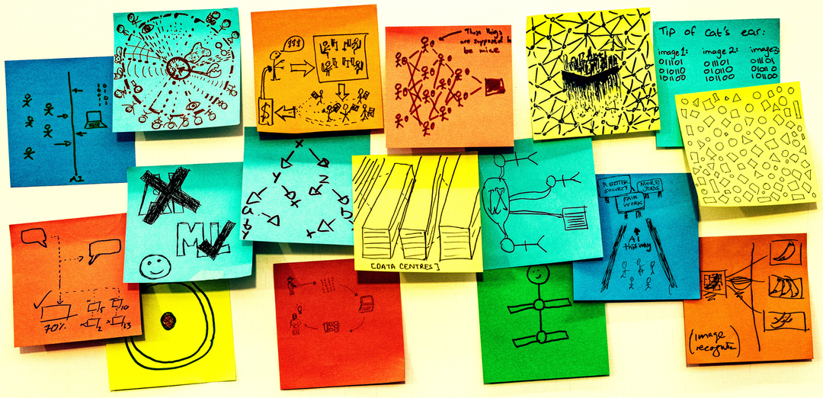

In this presentation
Data-informed decision making and students involvement
Study into student involvement without intervention
Study into student involvement with intervention
Rick Payne and team / Better Images of AI / Ai is... Banner / CC-BY 4.0

Slide 4

Part 1: Data-informed decision making and students involvement
This Photo by Unknown Author is licensed under CC BY-SA-NC

Slide 5



Data use for school improvement?
problem
solution

Slide 6
Data use for school improvement?
Increase numbers of hours
problem
solution
Low student achievement mathematics
Buy new curriculum materials

Slide 7

Data use for school improvement!
Problem
Use data
Solution
Increased school quality

Slide 8
Objective
Data use for school improvement with students
Little attention for the role of the students in the data use process
Students as a source of data vs active stakeholder in the use of data
“The object of change” vs “creator of change” (Yonezawa & Jones, 2007, p. 340)
Why and how to involve students in the use of data as active participants?

Slide 9
Why involve students?
In groups of 2-4 discuss reasons for (not) involving students in the use of data
Write down your answers via menti.com

Slide 10
Why involving students
Why involving students?
Innovation: To understand and address educational problems (Mitra, 2004; Yonezawa & Jones, 2007); Students see different problems and see problems differently (Fielding, 2001)
Learning: To develop data literacy, a core competence (OECD, 2019); to provide input to teachers on how to improve quality of teaching and learning (Fielding, 2003)
Justice: Students right to access and have control over their data (e.g., GDPR, FERPA); Students not involved in matters that involve them and have little influence on decisions that impact them (Smit, 2013)
Social: "from objects of change to creators of change" (Yonezawa & Jones, 2007); "from objects of investigation to agents of their own transformation" (Fielding, 2004); Students as valuable partners in the actual use of these data, inclusion

Slide 11
Benefits for students
Empathy, motivation, ownership
Reflection and confidence
Learning to collaborate, social skills, inclusion
Democratic skills, citizenship
Data literacy, research skills

Slide 12
Benefits for teachers and schools
Reflection and impact
Professional development
Improved teacher-student relations
Improved quality of education
Improved school culture and climate

Slide 13
Passive involvement
Passive involvement
Seeking opinion through student voice data
Institutional purpose (Kennedy & Datnow, 2011)
Improve certain indicators (Jones & Hall, 2021; Kennedy & Datnow, 2011)
Focus only on improving on accountability indicators (Datnow, Park, & Kennedy, 2008; Jones & Hall, 2021; Smyth, 2006)

Slide 14
active involvement
Active involvement
Dialogic model (Fielding, 2004)
Active, early engagement (Fielding, 2004)
Agency, inclusion, motivation, wellbeing
Learning and achievement (Jones & Hall, 2021; Mitra, 2004; Yonezawa & Jones, 2007)

Slide 15
How can we involve students in the use of data?
In groups of 2-4 think of ways in which you could involve students in the use of data
Share your best practices!
Write down your answers via menti.com

Slide 16
Student involvement in data use
Goal setting
Data collection
Data analysis and interpretation
Action planning and implementation
Evaluation

Slide 17

Part 2: Study into student involvement without intervention
This Photo by Unknown Author is licensed under CC BY-SA-NC

Slide 18
Research questions
Research questions
To what extent and how are students involved in the use of data at the school level?
What are the perceived effects of involving students in the use of data?

Slide 19
Method
Small scale exploratory study
National student survey in Norway (e.g., wellbeing, motivation, student participation)
3 purposely sampled (Cresswell & Clark, 2007) best practice schools
2 focus group interviews per school, one with students (2-3) and one with educators (2-3)
Semi-structured interviews: goal setting, data collection, data analysis and interpretation, action planning and implementation, evaluation
Interviews recorded via teams, transcribed via AmberScript, coded, case report for each school

Slide 20
Results: Goal setting
Student involvement in | School 1 | School 2 | School 3
Goal setting | Not involved | Not involved | Not involved

Slide 21
Results: Data collection
Student involvement in | School 1 | School 2 | School 3
Data collection | Filled in survey, rationale explained | Filled in survey, rationale explained | Filled in survey, rationale explained

Slide 22
Results: Analysis and interpretation
Student involvement in | School 1 | School 2 | School 3
Analysis and interpretation | Detailed results presented in the student council and well-being team. The results are also discussed in the classrooms (but without the actual report) | Results presented by the school leader and in the individual classrooms, in some classrooms in more detail than in other classrooms | Detailed results presented in the student council. Results discussed in the classrooms, sometimes full report on screen, other times orally focused on the goals set

Slide 23
I thought well-being and motivation would be higher. Now, there were 17 percent who didn't enjoy it and couldn't concentrate. That was pretty intense.
I remember a teacher went through it on a screen in front of the class and then like at least explained the things that was relevant to our class. It was usually in like a table where like it showed a number how positive or negative our class had responded and how positive or negative our school had responded

Slide 24
Results: Action development and implementation
Student involvement in | School 1 | School 2 | School 3
Action development and implementation | Teacher teams, student council and well-being team develop improvement suggestions. These are discussed in classrooms and implemented by teachers. | Teachers and students in the individual classrooms develop improvement suggestions, these are implemented by teachers and students | Teacher teams, student council and students provide improvement suggestions, these are implemented by teachers and students

Slide 25
We saw the result for like how we find ourselves in mathematics, for example. And then she ask us questions on how we can make like the students have more fun in like math or anything we find boring in class and how to improve the results from this year to next year.
The numbers of bullying and such, it is very important that we know that because it is mostly students who bully other students. So we got to be aware of it so that we can hopefully do something about it

Slide 26
Results: Evaluation
Student involvement in | School 1 | School 2 | School 3
Evaluation | Data use cycle (with other data), yearly check whether goals are reached. Teachers observe each other’s classrooms. Students involved in evaluation, as passive data source. | Data use cycle (with other data), yearly check whether goals are reached. Students involved in evaluation, as passive data source. | Data use cycle (with other data), yearly check whether goals are reached. Students involved in evaluation, as passive data source.

Slide 27
Results: Effects
 | School 1 | School 2 | School 3
Reasons for involving students | Student participation | Student participation Commitment Motivation Wellbeing Achievement | Student participation Ownership Wellbeing

Slide 28
The numbers of bullying and such, it is very important that we know that because it is mostly students who bully other students. So we got to be aware of it so that we can hopefully do something about it….. And also when it is the students who are or some of the students who are bullying, then they are a part of the solution, too. They got to be a part of solving the problem if they are the problem.
Plus, we feel involved. Yeah. It's nice to kind of like be involved because then we feel like we kind of are a part of something too….. Because we're taking responsibility for kind of making sure that everybody in our class feels good”

Slide 29
Conclusion and discussion
Conclusion
Students to some extent involved
Involvement of students: student council, grade levels, individual classrooms, special teams
Room for improvement, involving all students and involvement in goal setting (i.e., active and early involvement, Field, 2004)
Importance of dialogue in each step of the data use process
Missed opportunity to work on data literacy: by presenting the data analysis to students (graphs, tables etc.)
Involve students in all steps of the data use cycle, from goal setting to evaluation: Students: “got to be a part of solving the problem if they are the problem”
Can contribute to ownership, inclusion, wellbeing, and achievement

Slide 30
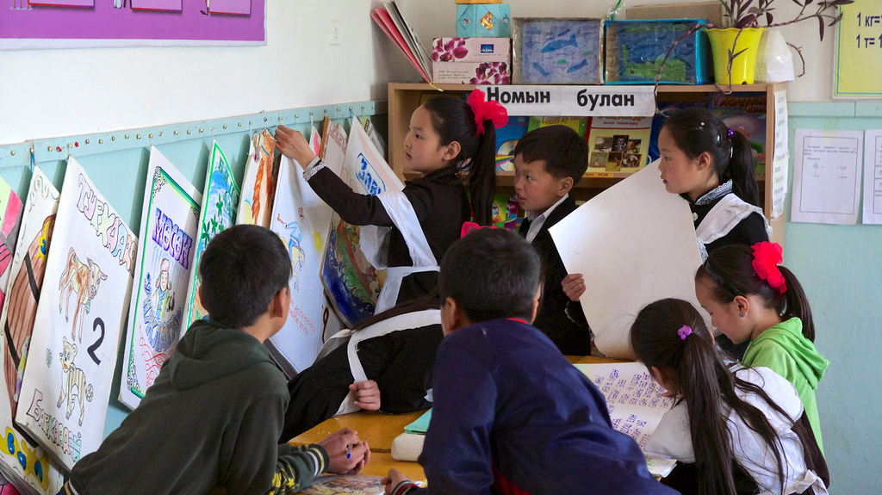
Part 3: Study into student involvement with intervention: PULSE project
This Photo by Unknown Author is licensed under CC BY-NC-ND

Slide 31
Intervention to involve students in the use of data
Data use via the PA model (Nordahl, 2016)
Using a whole classroom approach
Students are grouped in 4-6 (PLCs), they go through all the steps of the PA model in their PLC, supported by teacher
Pilot with 5 schools, grade levels 5-9 (students age 10-15)
Support of school leaders
SePU coaches

Slide 32
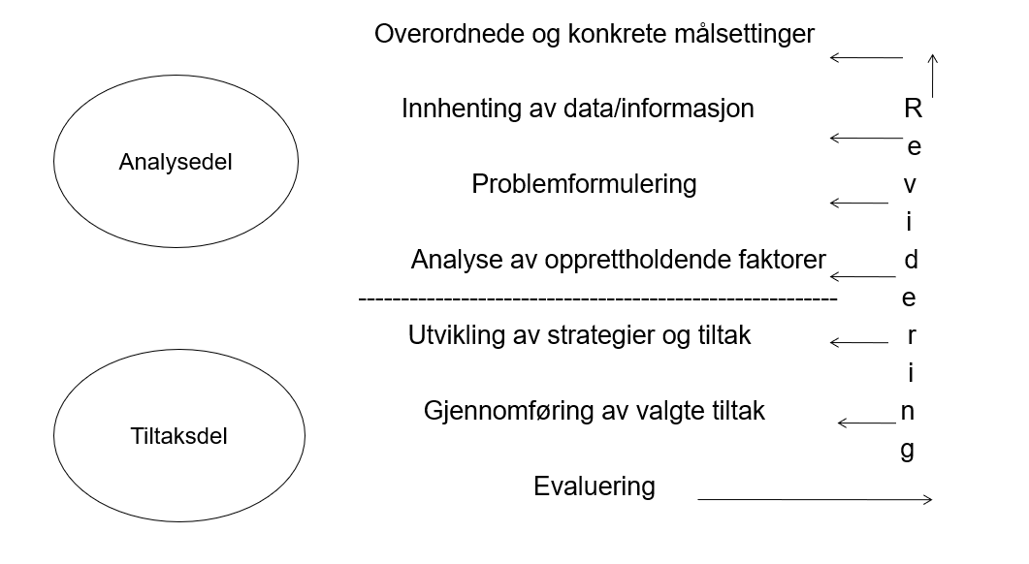
The Pedagogical analysis model

Slide 33
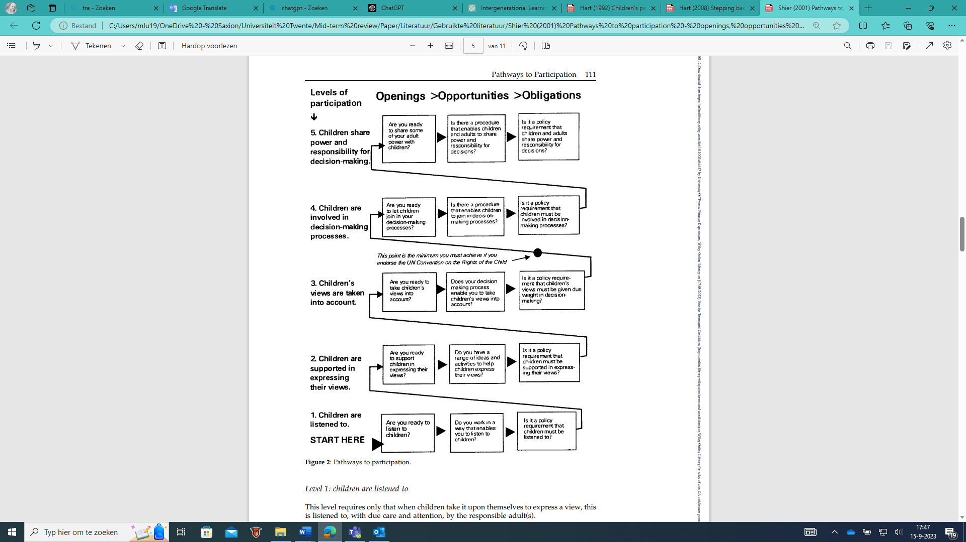
Student involvement
Shier, H. (2019). Student voice and children’s rights: Power, empowerment, and “protagonismo”. Encyclopedia of teacher education, 1-6.
Notes:
This project focusses on shifting the role of students from being “the object of change” to the “creator of change”
Shier addresses student voice children having the right to speak out and be heard on all matters affecting their education, linking it directly to participation processes. He presents five levels of participation. Although higher levels are not always better in every case, in this project our aim is to achieve level 4 and in some cases maybe even level 5.
A way of organizing student voice focused on levels 4 and 5 from Shier is by involving students in schools’ data use. Where we define data use as the systematic collection, analysis, and interpretation of different kinds of data to inform educational decisions with the goal of schools.
So the question we’d like to discuss in this session, is how to involve students actively in data use, in each phase of our model.

Slide 34
Preliminary Results
We talk about student involvement all the time, but we rarely really do it. Now we are actually doing it.

Slide 35
Overordnede og konkrete Målsettinger
Each student PLC starts with establishing overall goal based on SePU survey, teacher collects the input from the students
Teacher decides (level 4) on the goal based on student input or
Teachers and students collectively decide (level 5) on the goal (e.g., via a whole classroom discussion, via voting)

Slide 36
Overordnede og konkrete Målsettinger eksempel
The teacher presents 4 overall goals for the students. The teacher explains the objectives with examples that illustrate the objectives.
The students talk in their PLCs which of the 4 goals they think is most important.
The students put blue stickers on the goal they think is most important and red on what they think is second most important
Topics: wellbeing, motivation, and low levels of learning.

Slide 37
Innhenting av data/informasjon
Quantitative (e.g., surveys, assessment results) and qualitative data (e.g., classroom observations, interviews).
Data quality check.
The teacher (level 4) or the student PLCs together with the teacher (level 5) decide which data to collect and how to verify the quality of the collected data.
One of the participants: “We were surprised that students were actually able to understand the numbers and graphs from the survey and were able to reflect on it”.

Slide 38
Problemformulering
Related to the overall purpose and based on the data collected, a final problem and goal are formulated.
Each student PLC can individually formulate a problem definition and goal, after which all the problems are collectively discussed in the classroom and a final shared problem definition and goal is formulated by the teacher (level 4) or the teachers and students together (level 5).
Problem definitions are often phrased in the form of statements or why questions. Goals need to be measurable.

Slide 39
Analyse av opprettholdende faktorer
Each PLC in the class can formulate possible factors that contribute to the problem and the data needed to investigate this. Then all the PLCs present this to each other.
After the presentations, the teacher can decide (level 4) which PLC is going to be responsible for investigating which possible causes and which data to collect or
Teachers and students could together decide (level 5) on which PLC investigates which possible causes.

Slide 40
Analyse av opprettholdende faktorer eksempel
Students developed interview schedules and interviewed each other.
Results analyzed and grouped in different categories with the support of teacher.
Together with their teacher they decided on which factors to focus
Contributing factors: boring lessons, lack of feedback from the teacher, too many distractions in the classroom (too much noise), and explanations not always being clear.

Slide 41
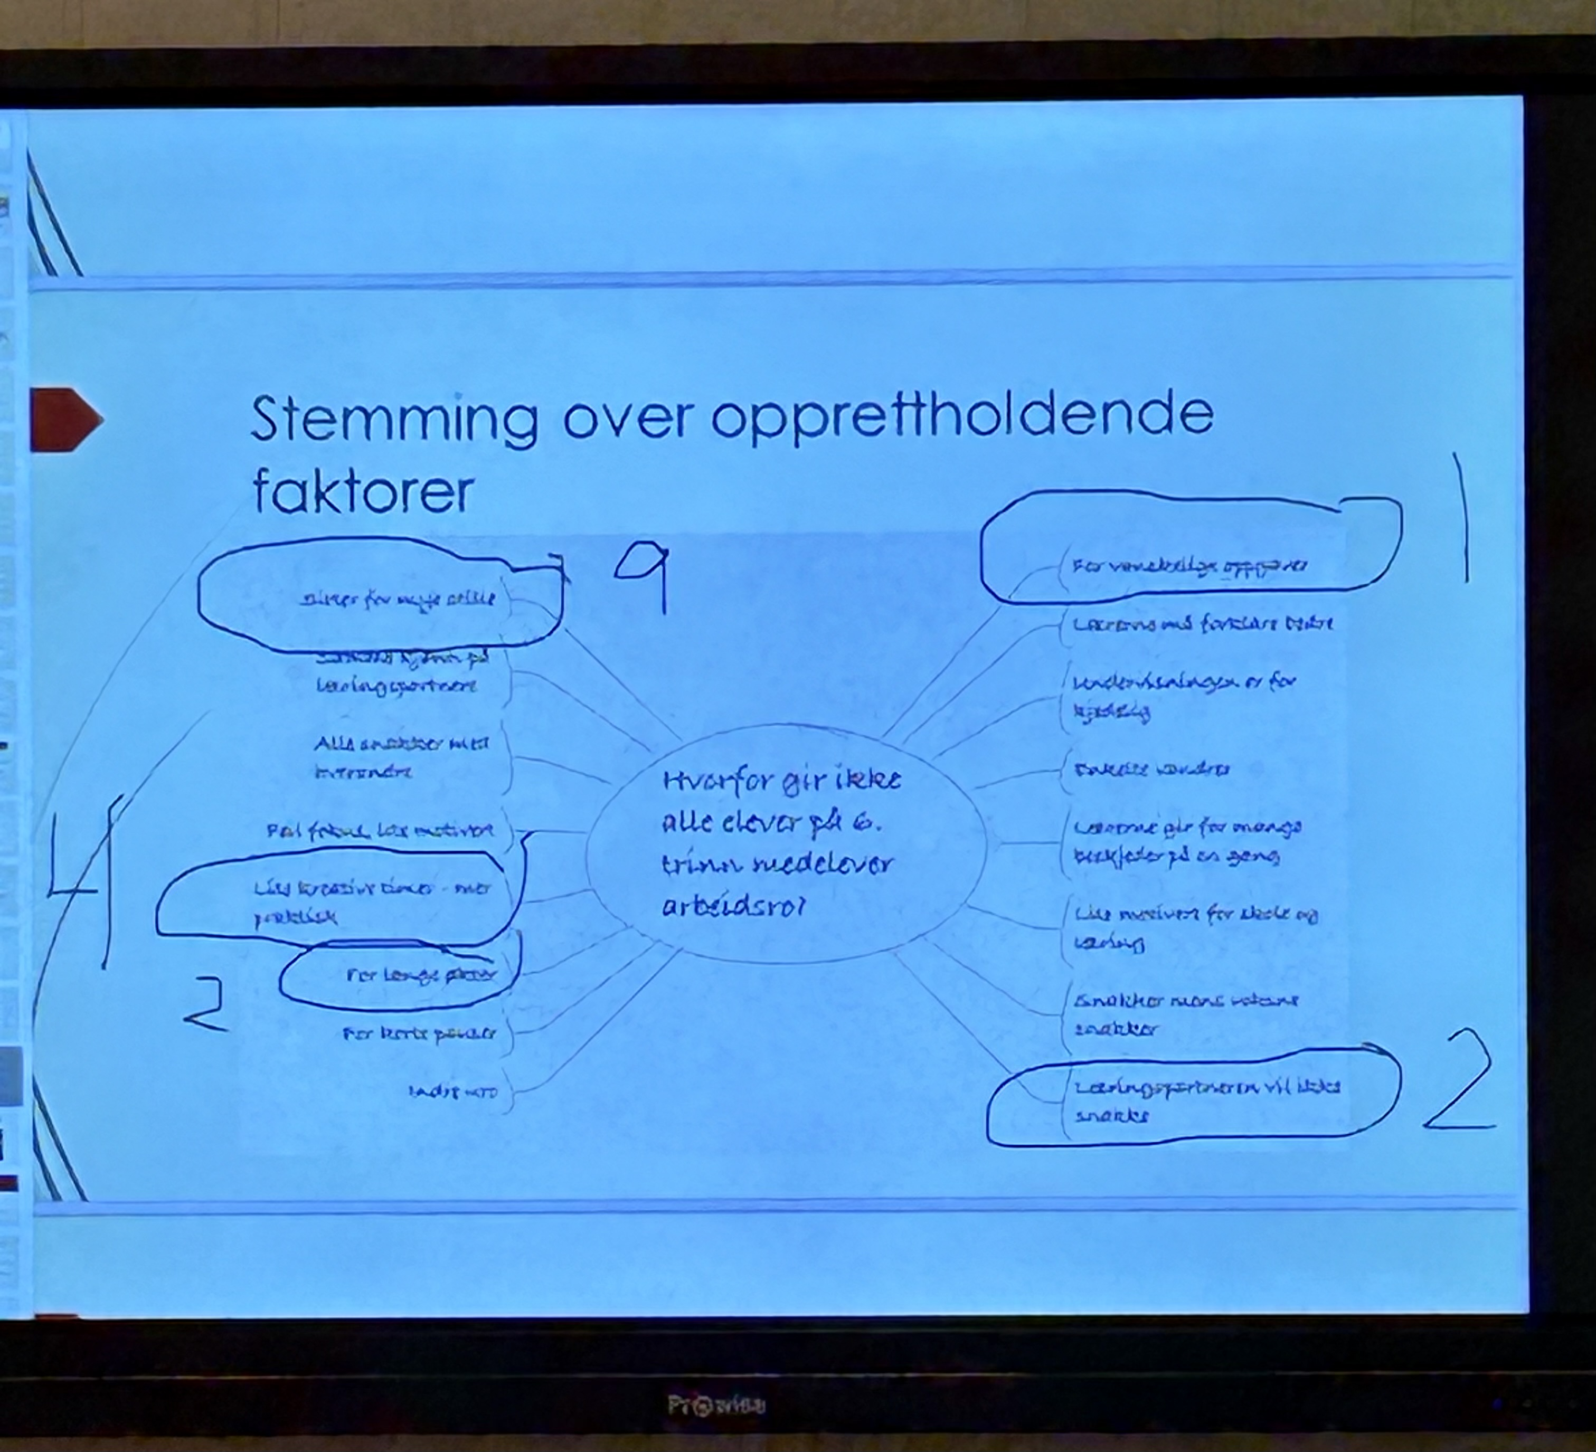
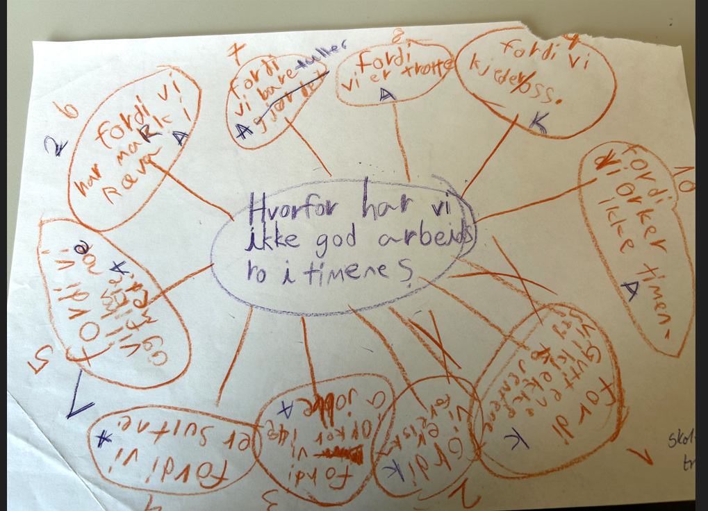

Slide 42
Utvikling av strategier og tiltak
The development of strategies is based on the analysis of contributing factors.
Select strategies based on research is advised.
Student PLCs brainstorm about strategies based on identified sustaining factors or select from a top-3 suggested by teachers and/or school leaders. Either the he teacher ultimately decides which strategies are going to be implemented (level 4) or this is collectively decided (level 5).

Slide 43
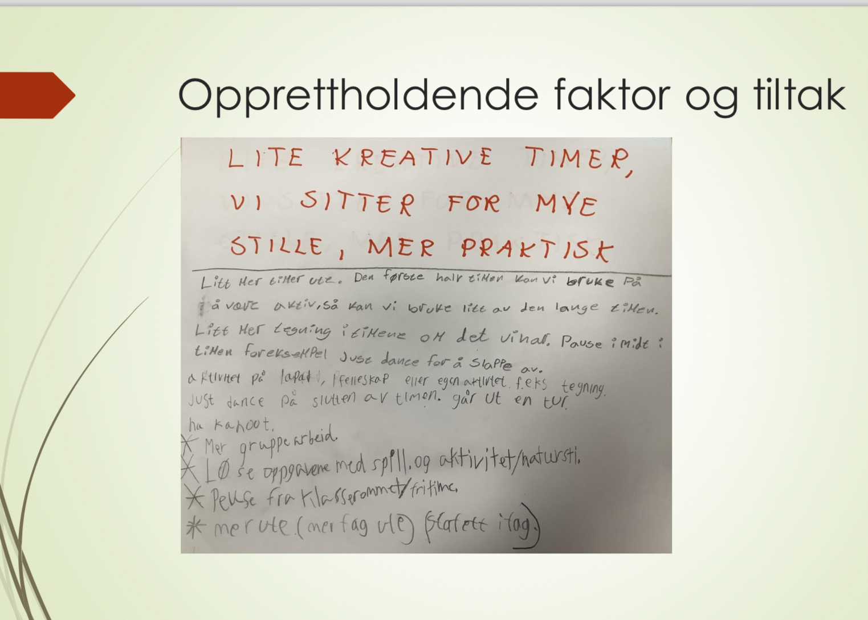
Utvikling av strategier og tiltak
After finding the contributing factors, the students wrote examples of actions for every sustaining factor
Students worked in PLCs
Moved around on stations
Everyone wrote something on each paper

Slide 44
Gjennomføring av valgte tiltak
When planning the implementation of strategies, careful consideration should be given to how they will be executed, who will be responsible for their implementation, and when they will be carried out.
The teacher can plan and implement these strategies together with the student PLCs. Here is can again be the teacher who ultimately decides this (level 4) or this can be done with the students (level 5).

Slide 45
Gjennomføring av valgte tiltak eksempel
Based on the contributing factors, the student PLCs formulated possible actions
One teacher made a link to research
Example strategies: more variation in activities (e.g., writing, a game, a video), more adaptive teaching (in the words of the students: explaining things in more different ways), more outside learning, more project work, more and different types of feedback (e.g., written and oral feedback, peer feedback), more group activities and cooperative learning, more breaks (i.e., paced lessons), and connecting homework more to what the students do at school.

Slide 46
Evaluering
Planning and conducting an evaluation of the work performed increase the likelihood of realizing new practices.
Regardless of whether the goals are achieved or not, it is important to evaluate the potential reasons for this.
In this step, for example each student PLC can develop an evaluation plan, and then the teacher decides who does what (level 4) or teacher and students do this together (level 5).

Slide 47
Evaluering eksempel
Schools are in the evaluation phase.
At the last seminar: They were all very enthusiastic and wanted to continue with this work.
One of the participants stated: “Students indicted that they never realized why they had to fill out these surveys, but now they get it and now they are demanding that they also want to be involved in the use of it. And it helps the school in getting better”.

Slide 48
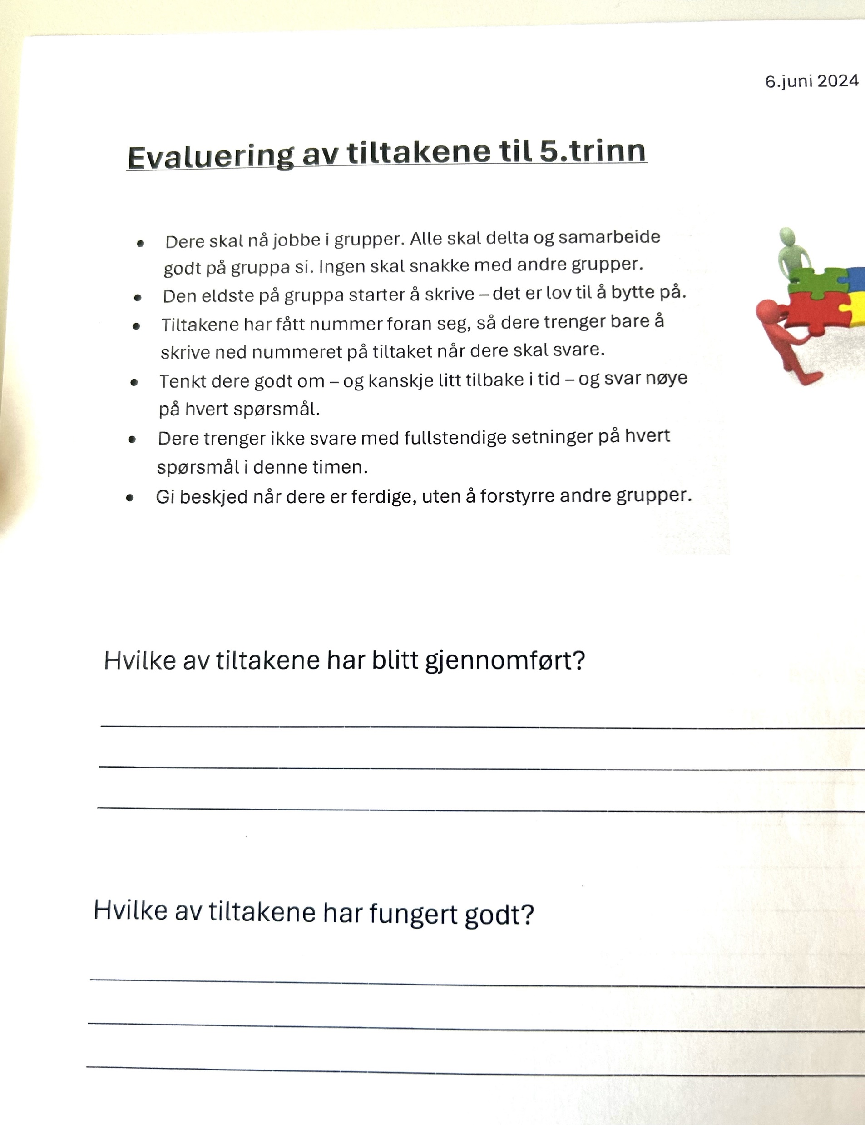
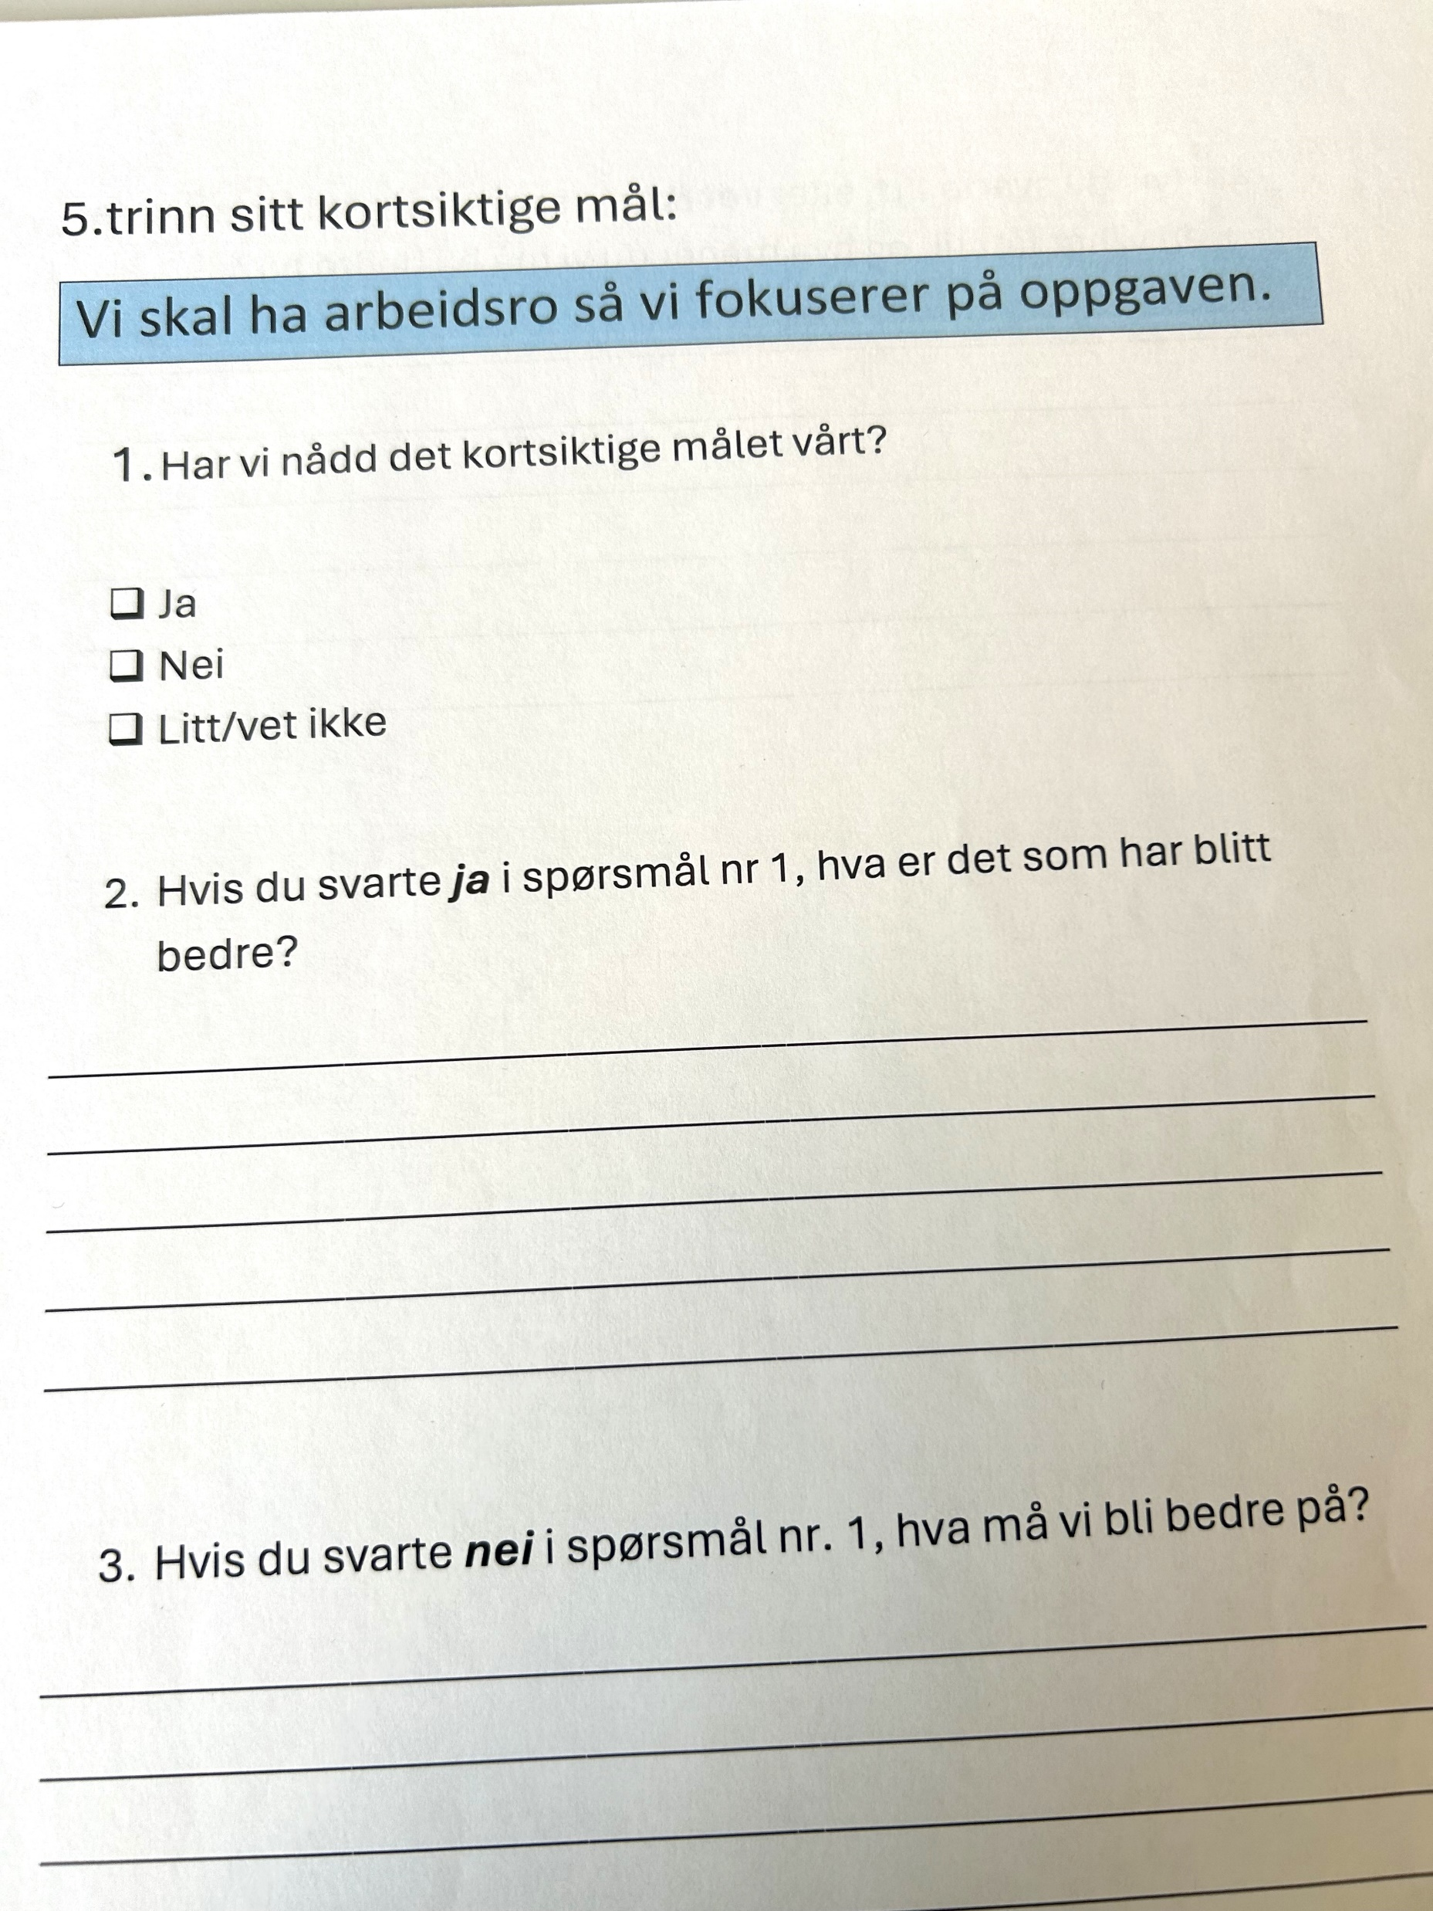

Slide 49
Our evaluation: Students
“Because then the pupils can help decide how the climate should be at school, for example. So that everyone gets a better school day.”
“Then we can decide how we want it to be in our class, with rules and things like that.”
“I guess we get to decide a bit, so it's not just a rule that no one bothers to follow in class. That it is not just the teacher who hopes that the rule will be followed, but that students can help to, for example, decide a little bit of how this rule should be followed.”
“Because then we will both see how we are all doing in our class, and what we are not so good at, we can fix that as we have done now.”
“Yes, so that we get better at it”

Slide 50
Our evaluation: Teachers
Benefits for students: ”The ownership relationship. I think that they will be more engaged in something they do themselves than if we had come up with it. Otherwise, it would not have been so successful. Also, the understanding of the process, that it is not always so easy when you decide and make choices. And that everyone gets to say their opinion, that everyone is heard, and that everyone gets to hear what the others think.”

Slide 51
Our evaluation: Teachers
Satisfaction with the intervention: “ I am so satisfied that there has been a change, and that the students have seen it themselves, even if it has been a bit of hard work for them along the way. And that is really the most important thing, that there is a change, and that they (the students) are aware of what and why, that there are questions or data we use that the students have answered. That the students see that we are addressing surveys they have answered, and that we (teachers) are working together with the students on the results.”

Slide 52
PULSE in your school?
In groups of 2-4: Would this work in your school? Why (not)
What are conditions for success?

Slide 53
Conclusion
Working with the PA model and the five levels of student involvement as a guideline.
Preliminary results are promising, positive effects mentioned by teachers and students.
Collaboration in PLCs and leadership crucial.
Further study conditions for succes
How can we enhance, scale-up and sustain this work?

Slide 54
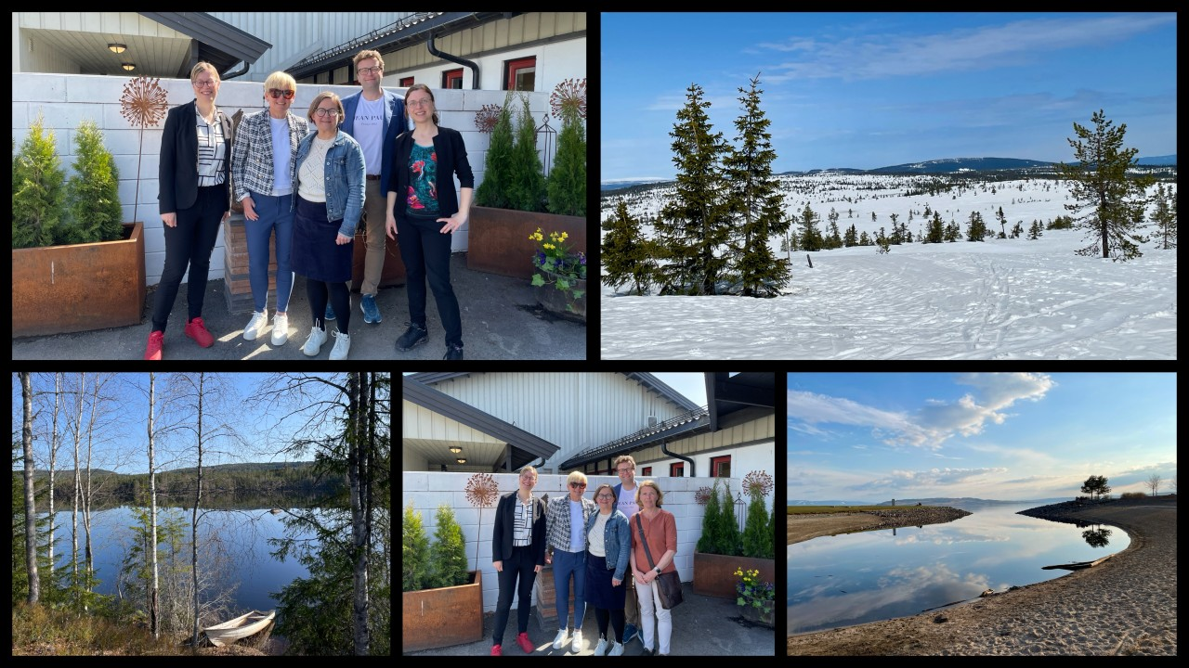
Thank you for your attention!
Contact: k.schildkamp@utwente.nl
Pulse team: Hilde Forfang​ (project leader), Anne Karin Sunnevåg​, Kjersti Håland​, Knut Olav Nordseth​, Thomas Nordahl, Lars Arild Myhr, Cindy Poortman, Kim Schildkamp

