Slide 1

TOOLBOX
The Rural Planning and Innovation Lab
(RUPIL)

Slide 2
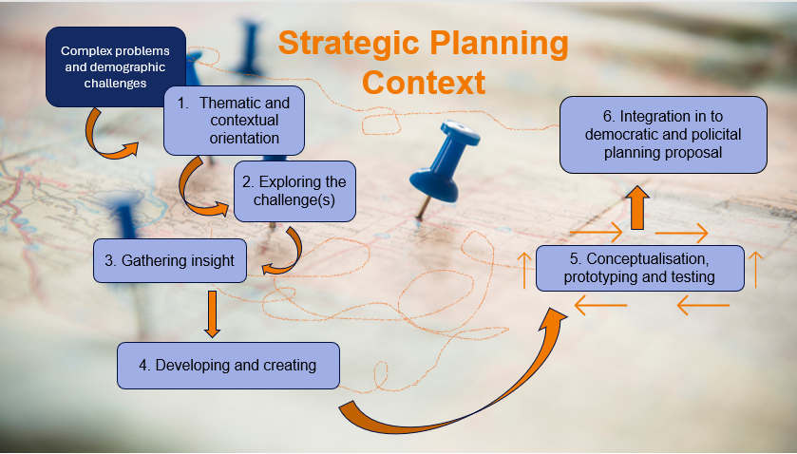
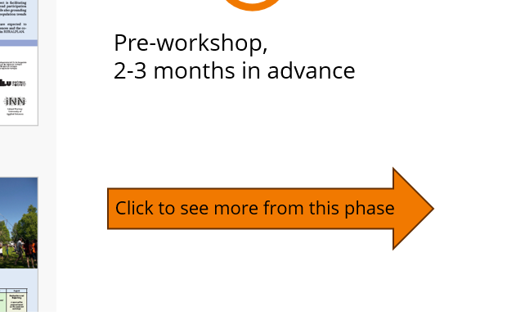


How to use this Toolbox
Use the presentation mode at any time
Click on the boxes to go to the explanation about the different phases in the RUPIL-process
Click the orange arrow to see tools for each phase
Click on the wheels to get back to the RUPIL model at any time in the process.
Click the binoculars to see other useful features during the RUPIL-process
1
2
3
4

Slide 3



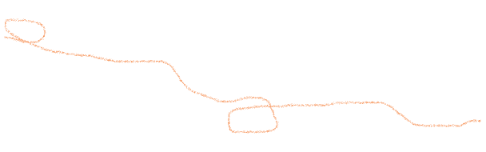

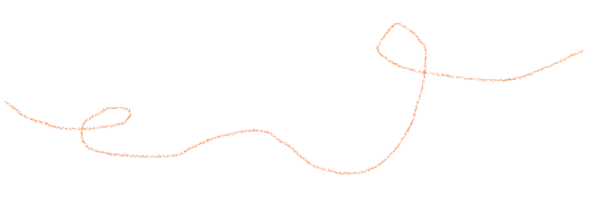

Complex problems and demographic challenges
Strategic Planning Context
Thematic and contextual orientation
6. Integrating the co-created results into democratic planning system
2. Exploring the challenge(s)
3. Gathering insight
5. Conceptualising, prototyping and testing
4. Developing and creation
Find your way back to this page at any time by clicking this symbol

Slide 4
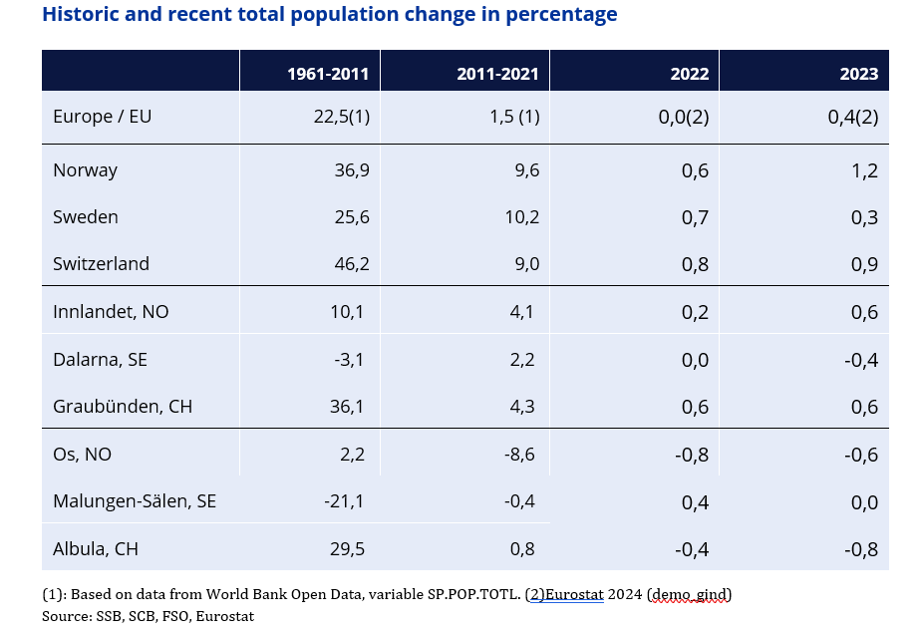

The strategic planning context
Strategic master planning is a vital activity in handling the complex demographic challenges and/or shrinking of rural societies in Europe.
The institutional context of strategic planning differs, as does the local and regional contexts. Therefore, knowledge of the institutional context of planning, as well as insight and analysis of the geographical and demographics is important for understanding the actual challenges, themes and issues vital for the success process in the insight phase.
Illustration of changing demography in specific countries, counties and municipalities
Click for more about the RUPIL in a planning context

Slide 5
The strategic planning context
The rural planning and innovation lab (RUPIL)
Demographic changes should not be trivialised, nor be met with population growth as only strategy or prerequisite for development. Instead, the RUPIL can help to empower planners in rural areas.
An arena for innovative planning in rural areas as a “rural living lab” in combination with an organized innovation process.
Methods for participation where the participants can collaborate in defining challenges in the local community, choosing which challenges they want to focus on and work with and giving suggestions to their solutions.
Ensure mutual learning and broad ownership of goals, strategies and possible solutions
Find new and innovative ways to utilize and adapt to demographic change
Click to get to rerequisites for the RUPIL

Slide 6
The strategic planning context
Important prerequisites in a RUPIL-process
The RUPIL model and process are framed within a strategic planning context, and the result is to be integrated into a democratic and political planning proposal, in most contexts.
The actual planning authority, either on the local, sub-regional, or regional level must ensure the legitimacy of the process in the insight phase, before starting with RUPIL-workshops.
Anchorage and cooperation with the planning authority ensures integration into the democratic and political planning proposal in phase 6.
In addition, the planning authority has important knowledge on the local context, discuss the selection of stakeholders/participants, and can contribute to the recruitment of workshop participants.
A good dialogue between the facilitator and the planning authorities is crucial to establish a common understanding during the RUPIL process.
It is important for the planning authority to get a good overview over the whole process, and what types of results to be expected
Go back to the RUPIL for the next phase

Slide 7

1 Thematic/contextual orientation
This phase in the RUPIL is about presenting the case, current planning processes, and framework for the processes.​
What should be done in phase 1:
  The invitation to the workshop contains practical information and a brief introduction to the main challenges for case municipality/region.
  The host (of this case – the planning context )-welcomes the participants and tell about the current planning processes, and the framework of the processes​.
  Finding statistics to present the context
Click here to see tools in phase 1

Slide 8
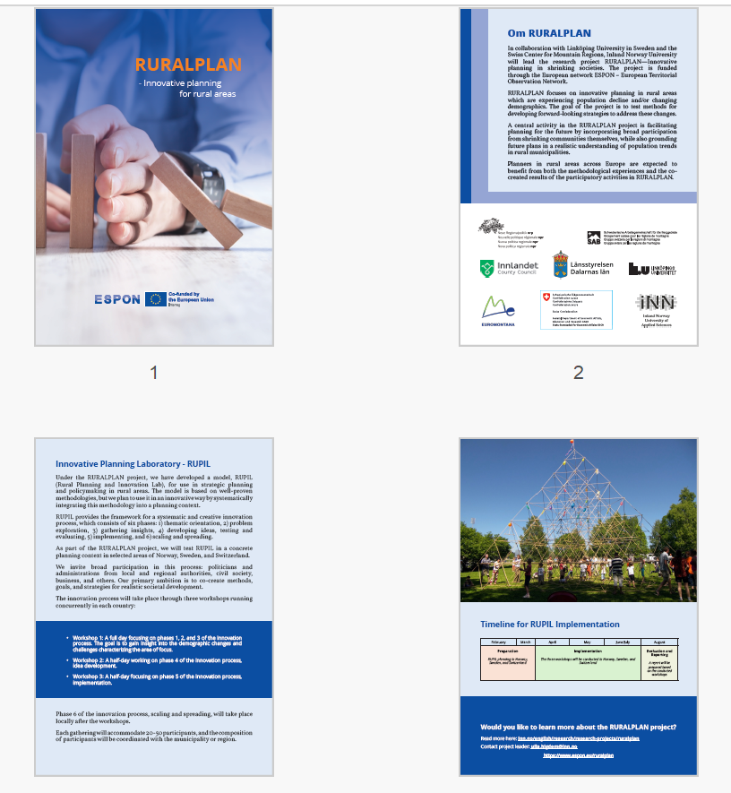

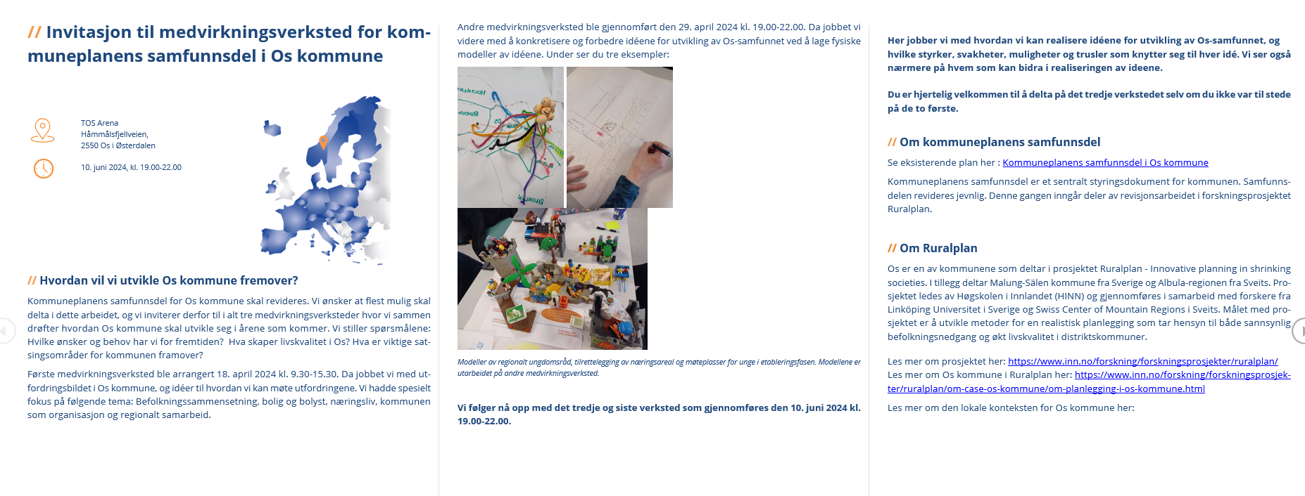

Phase 1: context
TOOLS
1
Pre-workshop,
2-3 months in advance
Short information pamphlet, about the RUPIL process, with an explanation of why facilitate RUPIL, the planning task ahead, and a timeline for all workshops
Invitation to workshops in collaboration with the host (municipality / region)
Click to see more from this phase
2

Slide 9
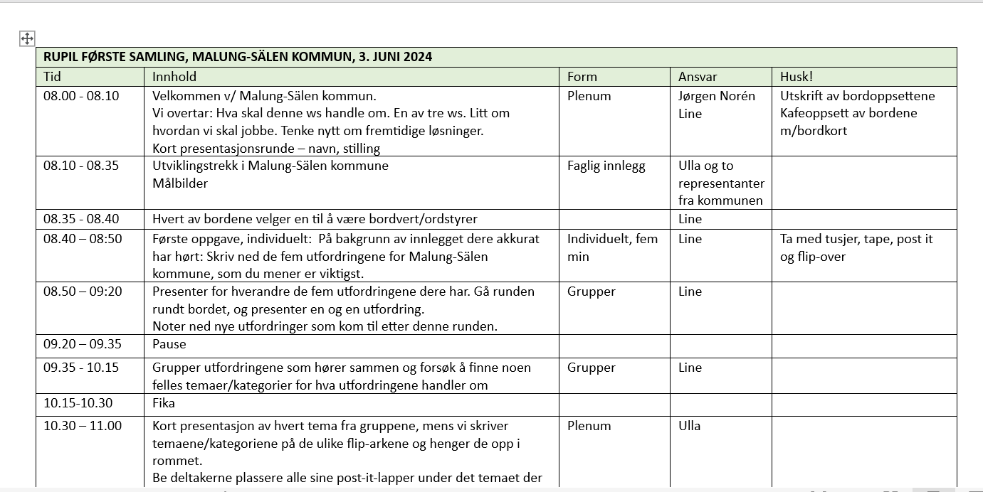
Phase 1: context
TOOLS
3. Preparing to present the actual situation and challenges numbers and visuals
4. Planning authorities present the actual planning task and how RUPIL is to be fitted into the process.
5. Discussing and preparing workshops with detailed timetable and necessary equipment.
Pre-workshop,
1 month in advance, facilitator together with municipality/planning authority
5
Go back to the RUPIL for the next phase

Slide 10
2 Exploring the challenges
About phase 2:
In this phase the RUPIL-workshop starts physically with exploring the challenges. What challenges are we facing? For whom is this a problem? What do we know about the consequences of this?
We explore the challenges to eventually have a unified understanding of what we are dealing with.
What should be done in phase 2:
Knowledge about the case municipality/region is presented (statistics and other relevant documentation) to the participants
The workshop facilitator must have identified the most important statistical findings, as well as other relevant documents and prepared av presentation of the material.
The realistic planning approach is explained.
Underline: Our starting point is the status of the municipality/region and realistic expectations for future development. Growth should not be the premise for development, there should be focus on quality of life.
Click to see tools in phase 2

Slide 11
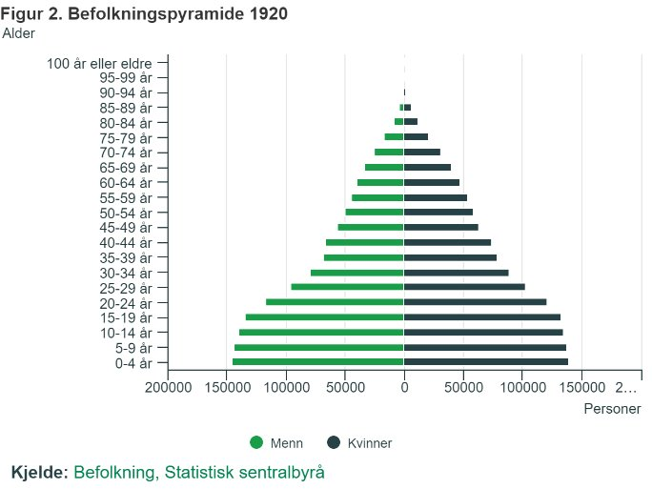
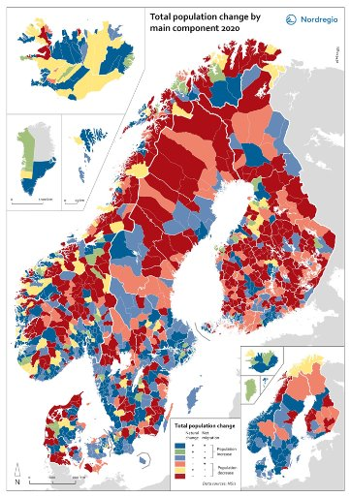
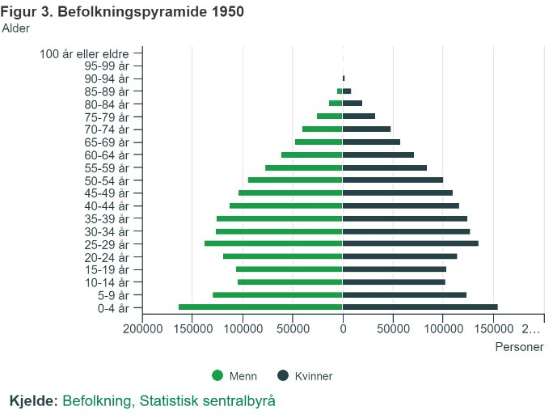
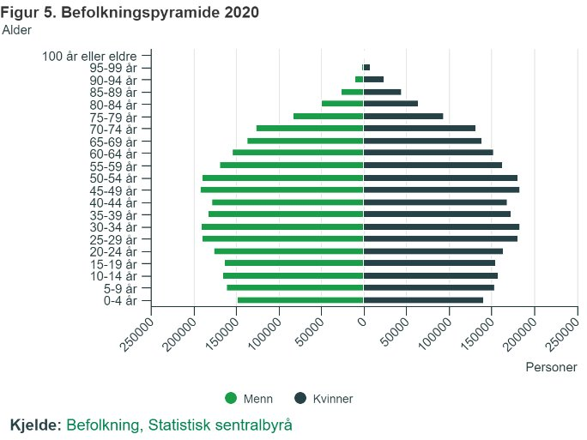
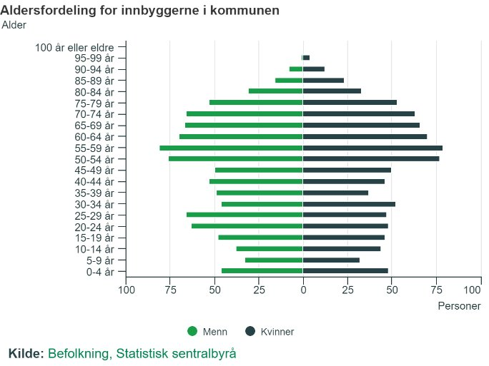
Phase 2: Exploring challenges
TOOLS
2
Norway 1920
1
Presenting the challenge in numbers and visuals. We recommend data on:
Shrinking in general
Age distribution in the country in general and municipality in particular, both historically and contemporary
Norway 1950
Norway 2020
Munici-pality 2023
Click to see more recommended data

Slide 12
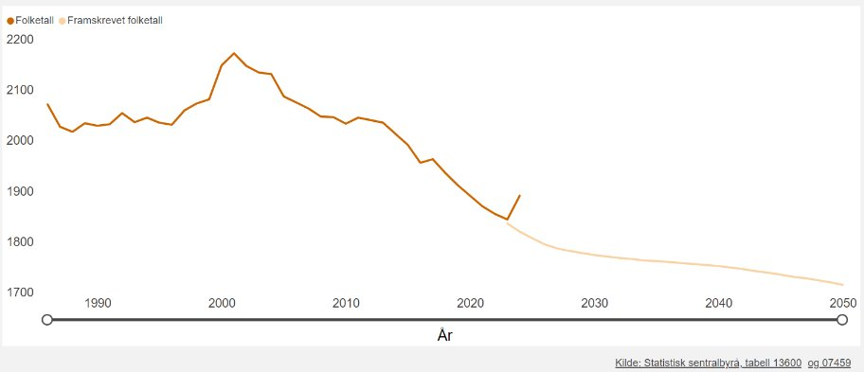
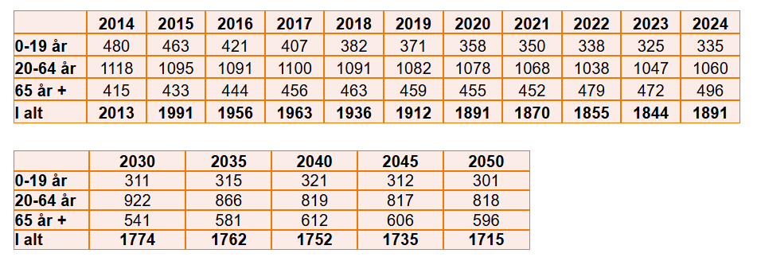
Phase 2: Exploring challenges
TOOLS
3
Continuing...
Presenting the challenge in numbers and visuals. We recommend data on:
3. Development in local population numbers, historical and forecast
4. Age composition and expected age composition of the local population
4
Click to see more tools for this phase

Slide 13
Phase 2: Exploring challenges
TOOLS
2 .The realistic planning approach
Planning and policy repsonses are most often met with Trivialization or Counter Strategies and more seldom with strategies of Acceptance and Adaptation or Exploitation.
Starting point:
Accept demographic challenges and/or shrinkage and find new and innovative ways to utilize and adapt
The realistic approach is underlining:
Population growth is not a prerequisite for development!
Go back to the RUPIL for the next phase

Slide 14
3 Gathering insight
About phase 3:
Gaining insight is about establishing a thorough understanding of a problem and seeing connections you have not seen before. Therefore, it is important to engage a broad selection of citizens, business actors, volunteers, politicians etc. to contribute with different perspectives and understanding of the problem(s), and to share how they want to participate and contribute to solving the problem(s).
What should be done in phase 3:
Gain insight from the participants at the workshop, by leading them through a three-step activity where they will describe their insights before they define and choose one main-finding that they will pursue further in the process.
Click to see tools for phase 3

Slide 15
Phase 3: Gathering insight
TOOLS
Step 1 Define insights
Instruction:
Write down five insights that you have discovered based on the presentations you have just heard. One insight per post-it-note.
Constitute groups of 4-5 people and present your insights to each other. Take the round, one by one.
Put your post-it-notes on a flip-chart and see if you can discover common features among all the insights. Categorize the insights according to a common theme.
Each group presents their categories/themes in plenary and the facilitator identifies common overall themes. Themes are written on a flip-chart. One topic per flip-chart. Hang them on the wall.
Constituting groups: The participants choose which theme they want to work on and go to the flip-chart that has this theme.
  NB! There should be a minimum of 3 participants in each group, a maximum of 6. The groups should be heterogeneously composed
6. Place all your post-it notes under the right flip-chart-theme
TIME:
Individual, 15 minutes
Group, 30 minutes
Group, 10 minutes
Group/plenum, 30 minutes
Individual, 15 minutes
6. Individual, 10 minutes
Click to get to next step in this tool

Slide 16
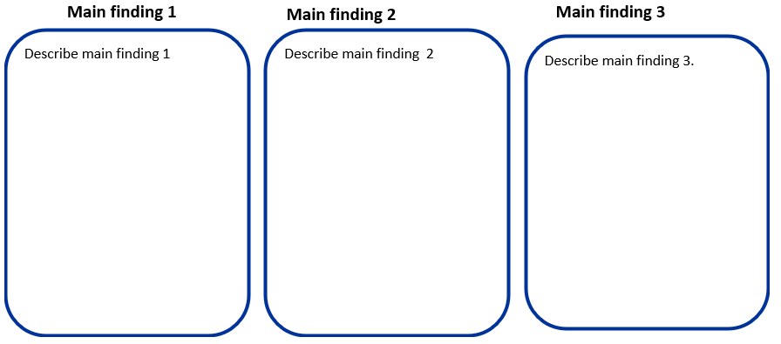
Phase 3: Gathering insight
TOOLS
Step 2 Main findings
The participants have chosen what theme they want to continue working on. The next step is to identity the main findings for this theme.
A main finding is usually formed when several sources point in the same direction. For example, if three people have described something of the same nature, it may indicate that this is something worth following up on.
Instructions:
Summarize your insights by formulating three main findings.
Describe your three main findings on the flip-chart and put it on the wall.
TIME:
1. Group, 20 minutes
2. Group, 20 minutes
click to get to next step

Slide 17
Phase 3: Gathering insight
TOOLS
Step 3 Main findings
Instructions:
Choose one main finding that the group wants to continue working on
  If you have problems deciding, you can have a democratic vote:
    Democratic voting, three votes per person: Vote for the main findings that you would like to work on further. You can either put all your votes on one theme or distribute them between three themes.
When you have chosen one main finding that you want to work on, you must reformulate the main finding into a “how can we- question”. By reformulating the finding into "how can we“- questions, we activate solution- thinking, which is what we will do in the next phase (phase 4).
  Reformulation: "How can we ....?"
TIME:
1. Group, 20 minutes
2. Group, 20 minutes
Go back to RUPIL for the next phase

Slide 18
Phase 4: Developing ideas
About phase 4:
We are now moving from problem exploration to idea development. Phase 4 consists of several elements, where the first part is developing ideas.
Idea development is central to innovation work. Creativity is conceiving, creating and being able to describe a new idea. In this phase, we will open for possibilities and ideas that can contribute to solving the problem. We are therefore dependent on bringing out many ideas. It is important that those involved in the process are open and build on each other's input.
What should be done in phase 4?:
Numerous methods and approaches can be of help in idea development, often involving a method of individual, group and plenary work (IGP). Key elements are:
creating trust among participants,
assembling multidisciplinary teams,
having a facilitator
utilizing various creativity-enhancing methods.
Click to see more about this phase

Slide 19
Phase 4: Developing ideas
Advices that apply for this phase:
Quantity over quality
Think outside the box
Build on each other's ideas
Create a diversity of ideas – uncritically
Everyone must participate - avoid group thinking
Think broadly – ​​challenge common thought patterns
Click to see tools in phase 4

Slide 20
Phase 4: Developing ideas
TOOLS
Brainstorming
Instructions:
Write a solution to the problem in each of the eight squares
TIME:
Individual, 15 minutes
How can we?
Click to see more from this phase

Slide 21
Phase 4: Developing ideas
TOOLS
Yes! And…!
Instruction:
The intention of this task is to build on and further develop each others’ ideas.
One begins with generating ideas alone and then share with others, to generate as many ideas as possible.
Participants: Individual and in groups
Equipment: Each participant is given a ready-made A3 sheet with three columns on which to write and further develop ideas.
TIME:
Total 45 minutes
Idea 1 | Idea 2 | Idea 3
Click to see more instructions from this phase

Slide 22
Phase 4: Developing ideas
TOOLS
Yes! And…!
Idea 1 | Idea 2 | Idea 3
Description of the idea
Write down three possible solutions/ideas under idea 1,2 and 3
Further development of the idea
Build on other people’s ideas in the next round
Further development of the idea
Build on other people’s ideas in the last round
Click to see how to use this sheet

Slide 23
Phase 4: Developing ideas
TOOLS
Yes! And…!
Instruction:
Use the model from the previous slide. Write down the "How can we..." question on top of the sheet.
Think of three possible solutions to the problem, three ideas for a solution each, which are entered in each of the three columns.
Pass the sheet on to the person sitting to your right. Now everyone has a new sheet of paper in front of them with three ideas on it. Now you must build on, detail and expand the idea above.
Repeat one more round - pass the sheet to the person sitting to your right. Build on, detail and expand the ideas you have on the sheet in front of you. Repeat again for the last time.
After three rounds, you stop writing and share your ideas in the group. Each person gets about one minute to present the three ideas they now have on their sheet in front of them (their original sheet)
TIME:
Individual, 5 minutes
Individual, 5 minutes
Individual, 5 minutes
Group, 15 minutes
Click to see more tools from this phase

Slide 24
Phase 4: Developing ideas
TOOLS
Idea – Evaluation
Various criteria can be utilized for idea evaluation. Frequently, we employ matrices, combining at least two parameters that facilitate idea discussion and potential assessment. Typically, our matrix incorporates parameters such as 'Implementation'—measuring the ease or difficulty of idea execution—and 'Effect/Value'—evaluating the impact or worth of the idea.
TIME:
Group, 20 minutes
Group, 20 minutes
Instruction:
Use the matrix (next foil) and discuss where in the matrix the ideas belongs. One person from each group takes responsibility for placing in the matrix. Write on post-it notes!
Vote for one idea you want to further develop and test. Democratic voting, three votes per person: You can either put all your votes on one idea or distribute them between three of the ideas.
Click to see the matrix tool

Slide 25
Phase 4: Developing ideas
TOOLS
Idea – Evaluation
Easy to implement
Small effect/value
Big effect/value
Difficult to implement
Go back to the RUPIL for the next phase

Slide 26
Phase 5: Conceptualisation, prototyping and testing
About phase 5:
In this phase the groups will first conceptualize the idea. The concept description serves as the foundation for the next step, the creative phase known as prototyping. The prototype will subsequently be tested, evaluated, and refined. This iterative process may be repeated multiple times until the prototype is ready for implementation.
What should be done in the conceptualization part of phase 5?:
The concept is a description of the idea, how should this service cover the user's needs, what elements it should consist of, what activities etc.
Click to see how to conceptualise

Slide 27
Phase 5: Conceptualisation
TOOLS
Describe the idea
Go back to the chosen idea from phase 4 and describe the idea as concrete as possible.
TIME:
Group, 15 minutes
Instruction:
Who are the participants,
What is the content,
How will this service meet the user’s needs,
What components will it include,what activities,
What timeline
Click to see the next step in phase 5

Slide 28
Phase 5 Conceptualisation, prototyping and testing
About the prototyping part of phase 5:
The concept description forms the basis for prototyping.
A prototype is a preliminary version of a product, service, or process. It serves as a sketch or model of our idea, allowing us to discuss, test, and evaluate it. The aim is to test an idea quickly and inexpensively, gathering input and feedback to refine the idea. While it is impossible to prototype every aspect of a product, service, or process, we can select specific elements to prototype.
What should be done in the prototyping part of phase 5
Prototyping is an iterative process designed to visualize and test the final solution with the user group before implementation.
The facilitator should bring different material to use in different prototypes
Click to see different ways of prototyping

Slide 29
Phase 5: Prototyping
Different ways of prototyping
There are various methods of prototyping. You can create a physical prototype using materials such as paper, markers, pipe cleaners, clay, Lego, Duplo, etc. If prototyping a service, you can role-play the innovation. You can create classical storyboards as in filmmaking, or develop a digital presentation of your prototype. Choose the type of prototype that best fits your concept.
Physical prototypes (Mock-ups)
Role playing, theatre
Storyboard
Digital
Time:
Group: 60 minutes
See examples of prototypes in a planning context

Slide 30
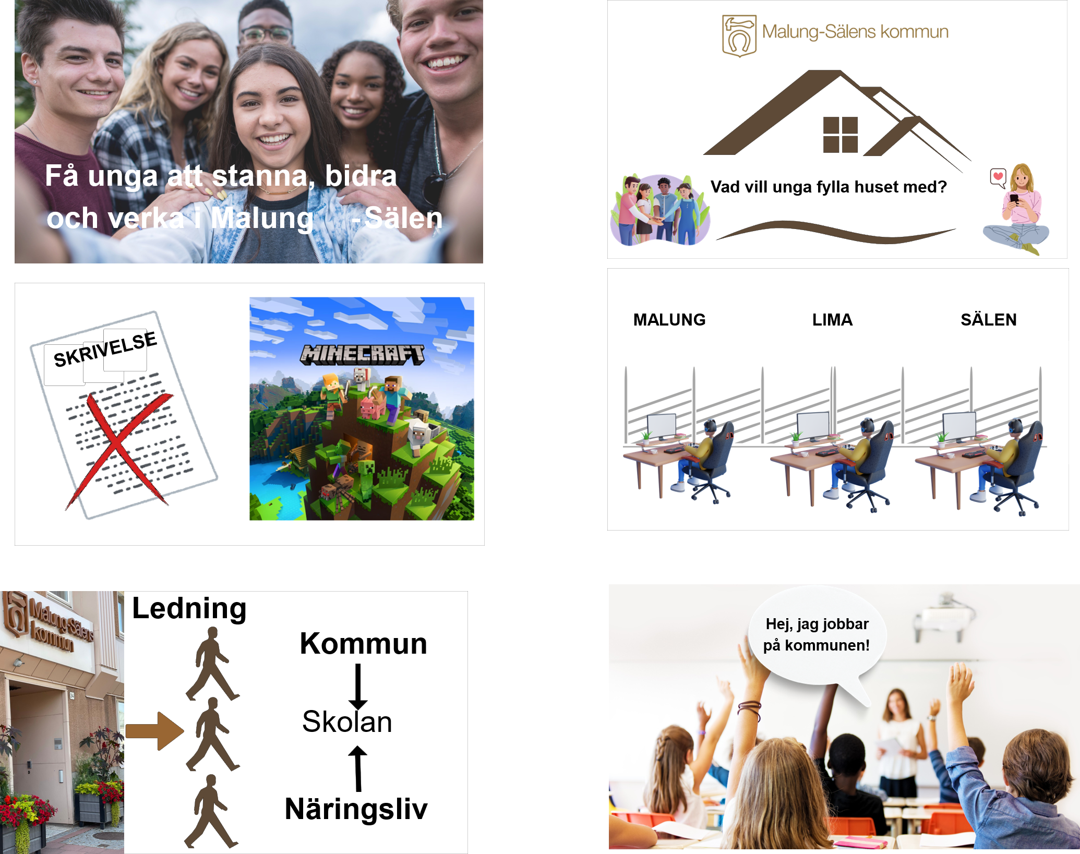
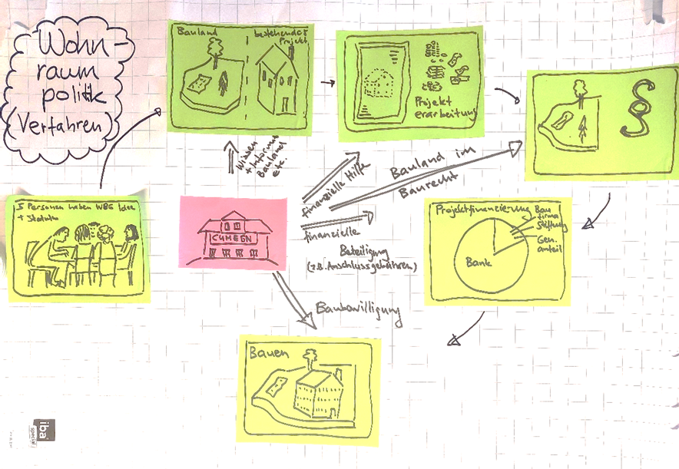
Phase 5: Prototyping
Examples of prototyping in a planning context
A storyboard is widely used in filmmaking. It sequentially illustrates the narrative, providing a step-by-step visual representation of events..
Digital storyboard about developing an attractive place
Storyboard about housing policy
See more examples of prototypes in a planning context

Slide 31
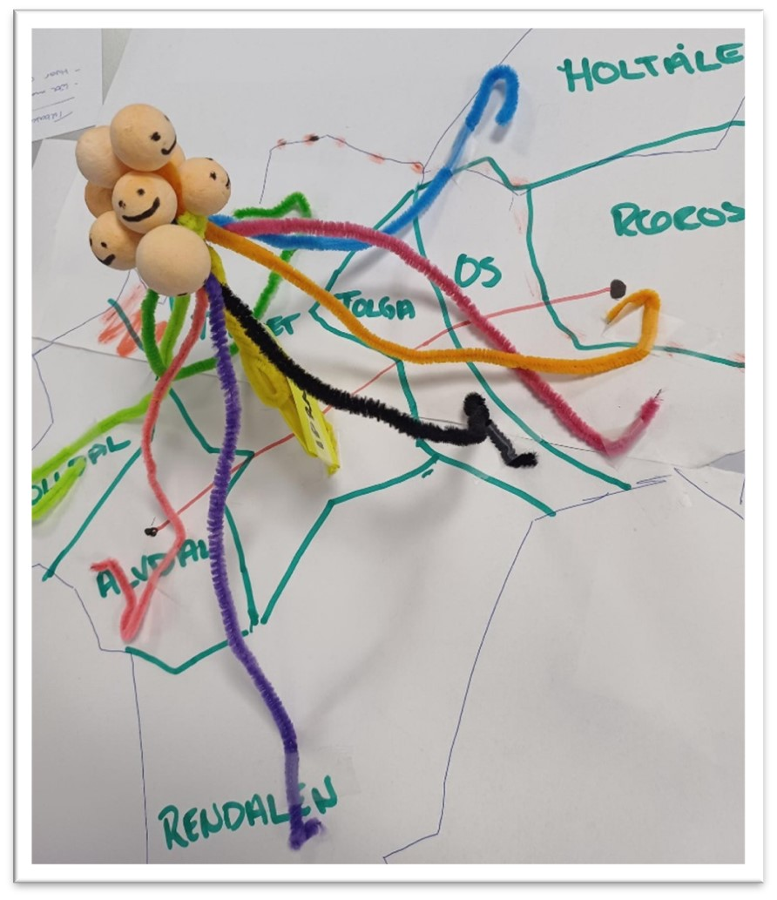
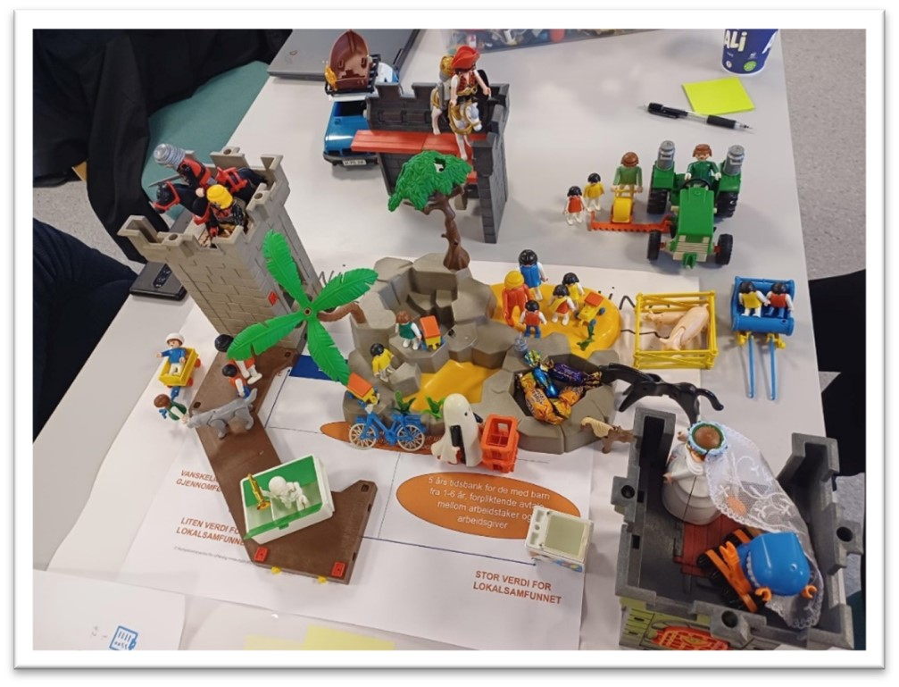
Phase 5: Prototyping
Examples of prototyping in a planning context
Physical prototypes:
May be very simple representations, or comprehensive ones that include product details and correct appearance
Not necessarily functional, but used to simulate situations
Ensures that you spend time on what is important – not visual design, but connections and sequences
Physical prototype about a Regional Youth Council
Physical prototype about meeting places
See more examples of prototypes in a planning context

Slide 32
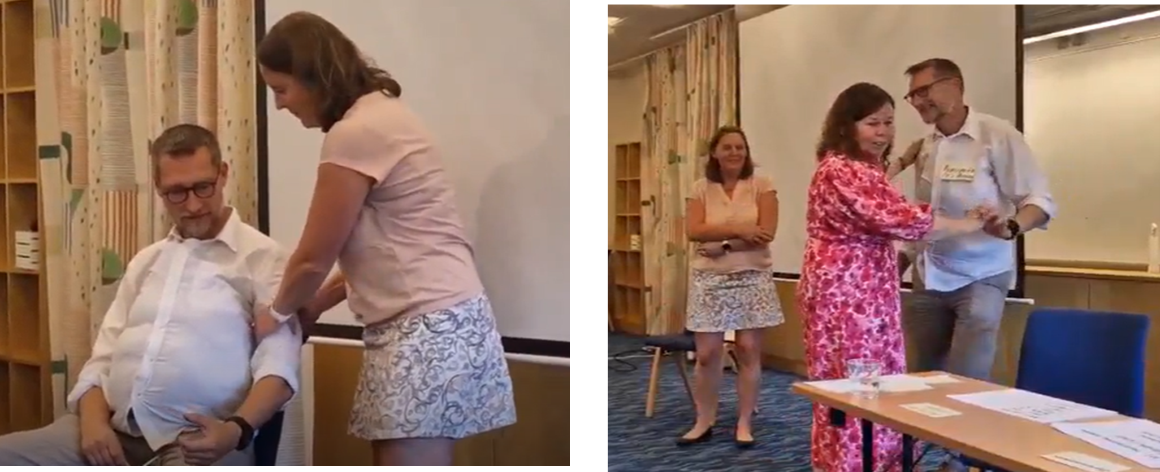
Phase 5: Prototyping
Examples of prototyping in a planning context
A role play helps to show how a user might interact with the idea, product or service. It can adapt to many different scenarios and contexts.
Role play about seniors and health care services
See the next step in phase 5

Slide 33
Phase 5 Conceptualisation, prototyping and testing
About the testing part of phase 5:
Phase 5 concludes with the testing of the prototype. All participants engage in testing and evaluating each other’s prototypes.
What should be done in this part of phase 5:
The prototypes are presented
Other participants give feedback
The groups adjust their concept and prototype according to the feedback
The groups conduct a SWOT-analysis on their idea
The groups adress roles and responsibilities to prepair the idea for further integration in the democratic planning process in phase 6
See tools for the testing part of phase 5

Slide 34
Phase 5: Testing
TOOLS
Café dialogue
.
In a café dialogue, the participants go from table to table to give feedback on the prototypes. One or two of each group will remain at the table to present the prototype. The other group members will be visiting the other groups.
Instruction:
Choose a table host and a referent to remain at the table, presenting the prototype.
When the facilitator starts the dialogue round, the table host welcome the guests and present the overall innovation question and the group's prototype.
The guests ask questions to clarify ambiguities (what, how, which).
Afterwards, the guests give their feedback on how they perceived the prototype, and suggestions for improvements.
The feedback is written down by the referent.
TIME:
Instruction, 10 min
Each round takes 10 min.
Total time depends on how many groups there are.
Click to see the next step in the café dialogue

Slide 35
Phase 5: Testing
TOOLS
Café dialogue
.
When the rounds have been completed, the group must gather again and process the prototype after feedback and suggestions for improvements.
Instruction:
The table host presents the feedback that has been received
Everyone in the group spends a few minutes individually thinking about adjustments and improvements to the prototype
Go around the table and let all the participants present their input for improving the prototype.
Process and further develop the prototype based on all the new input.
TIME:
Group, 15 min
Individual, 5 min
Group, 10 min
Group, 30 min
Click to get to the next tool in this phase

Slide 36
Phase 5: Testing
TOOLS
SWOT-analysis
What are the strenghts, weaknesses, opportunities and threats when you consider the implementation of your solution or idea in relation to realistic planning?
TIME:
Individual, 10 min
Group, 20 min
Group, 30 min
Instruction:
Continue working in the groups from workshop 2
Use the matrix (next foil) and write down your thoughts about strengths, weaknesses, opportunities and threats in relation to the implementation of your solution/idea
Share your thoughts in the group
Sum up the main findings in a common matrix
Click to see more about the SWOT

Slide 37
Phase 5: Testing
TOOLS
SWOT-analysis
STRENGHTS
What are the strengths of your concept? What can be achieved by the implementation of your solution?
WEAKNESSES
What are the weaknesses of your concept? Is your solution sustainable? Is it realistic?
OPPORTUNITIES
Which actors should be involved in the realisation of the solution? Who can contribute?
THREATS
How should you manage threats or obstacles during the implementation?
Click to see more tools for phase 5

Slide 38
Phase 5: Testing
TOOLS
Roles and responsibilities
We focus on the opportunities and threats in relation to the implementation process and discuss who can follow up opportunities and threats respectively and how this can be done
TIME:
Group, 40 minutes
Instruction:
Use your main findings on opportunities and discuss the different actor’s roles and responsibility in the implementation process:
    Who can contribute in the realisation of your idea and how (civil society, businesses, the municipality/region)?
    Who can help you manage and minimize the conditions that threatens the implementation of the idea?
Click to see more about this tool

Slide 39
Phase 5: Testing
TOOLS
Presentation of the final ideas
The solutions and ideas are presented to the whole group of participants
TIME:
Group, 20 min
Group, 10 min each
Host, 10 min
Instruction:
Prepare a presentation of your solution/idea. The presentation should contain
    A description of your theme and “how can we”-question
    A review of your prototype
    Your perspectives on who can contribute to the implementation of the concept and how
Present your work
The host (case municipality/region) presents a plan for following up the solutions/ideas in the local/regional planning processes.
Go back to the RUPIL for the next phase

Slide 40
Phase 6 Integration in to democratic and political planning proposal
About phase 6
    In this phase the co-created solutions and ideas should be integrated in the local context. The solution and ideas are to be fed into the local and/or regional strategic planning process and the fame of realistic planning.
  What should be done in this phase:
  The final ideas are presented to relevant authorities.
  RUPIL may be applied as a main approach to seek and develop innovative strategies and solutions in the planning process, or as a vital part of the process. Ideally this has been decided in the insight-phase and is put in action now.
  The planning authority decides how the results of RUPIL should be integrated into the ordinary governmental procedure of the planning activity, providing democratic legitimacy as well as ensuring legal and formal confirmation on collaborative activities and the government’s commitment to collaborating governmental bodies at different levels, interests, and actors by an action program.
Go back to the RUPIL or see extra tools and tips

Slide 41
Extra tools and tips
Realistic timeline:
Already at the start of the RUPIL process it can be useful to make realistic timeline for the whole proces. This will give potential participants an idea of what is expected of them. A full RUPIL-process takes one whole day for phase 1-3, half a day or one night for phase 4 and half a day or one night for phase 5. Phase 6 is happening post-workshop, in other democratic forums.
Scenario workshop for planning process:
A scenario workshop can be used as a kick off for the planning process. This is also a good way to mobilize inhabitants, to give them ownership to development of their own municipality and it can inspire planners.
Evaluation:
At the end of workshop 3 and phase 5 it might be useful to evaluate the RUPIL-process together with the participants. This can help to adjust the activities for next time, but also give useful insights to take along in phase 6. Tools that can be used here are free tools from platforms as mentimeter, google forms, ahaslides, kahoot or just Post-its.
Click to see example of a workshopprogram and timetable
Click to see example of a scenario workshop

Slide 42
Extra tools and tips
TOOLS
Timeline, example workshop program
Workshop 1
9.30 | Welcome by host, quick presentation of participants (phase 1)
9.45 | Presenting the context in data (phase 1)
10.15 | What are the challenges? (phase 2 and 3)
10.30 | Short break
10.45 | What are the challenges (continues, phase 3)
12.00 | Lunch
12.45 | 12.45: Choose idea to work with (phase 3)
13.30 | Short break
14.00 | What can be solutions for the challenges (phase 4)
15.25 | What we will do next time
15.30 | End of workshop 1
Workshop 2 (a few weeks after workshop 1)*
19.00 | Welcome by host
19.10 | Re-cap from workshop 1, which ideas will we work with? (phase 4)
19.30 | Conceptualisation and prototyping (phase 5, step 1 and 2)
20.20 | Short break
20.35 | Presenting prototypes (phase 5)
21.30 | Processing prototypes after feedback (phase 5 step 3)
21.50 | What will we do next time
22.00 | End of workshop 2
Workshop 3 (a short time after workshop 2)
19.00 | Welcome by the host
19.10 | Re-cap from workshop 2 (which prototypes did we make)
19.20 | SWOT-analysis (phase 5)
20.00 | Short break
20.15 | Roles and responsibilities (phase 5)
20.40 | Presentation of final idea and discussion (preparation for phase 6)
21.40 | Evaluation
22.00 | End of workshop 3
*A workshop at night might be easier for people with day jobs
See a timetable and necessities

Slide 43
Extra tools and tips
TOOLS
Detailed timetable and necessities for workshop 1
See more extra’s

Slide 44

Extra tools and tips
TOOLS
Scenario workshop for inhabitants
TIME:
About the planning process: appr. 25 minutes
About the context: appr. 20 minutes minutes
Compressed workshop: 60 minutes
Click see more tools for a scenario workshop
Example of invitation to citizens to join a scenario workshop about the planning process

Slide 45
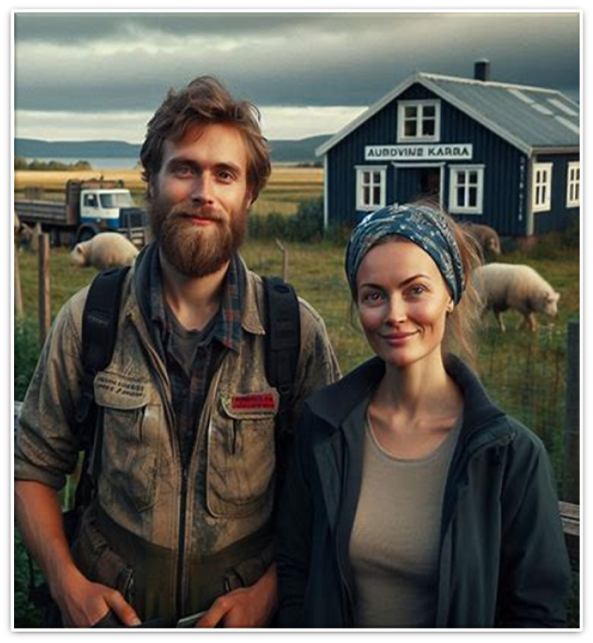
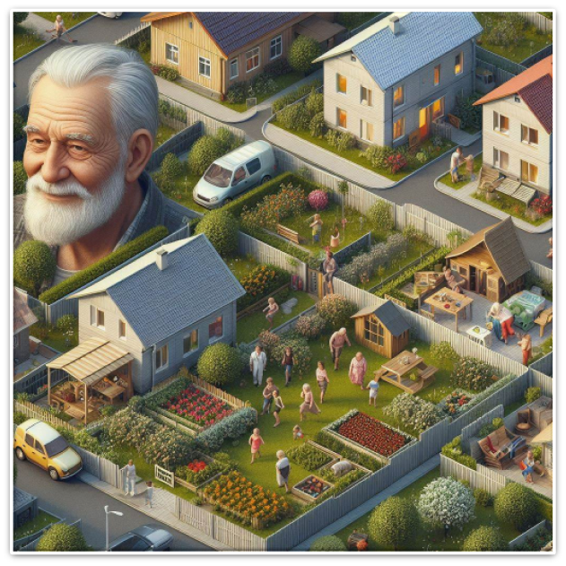


Extra tools and tips
TOOLS
Scenario workshop: personas
Introduction:
Four personas are presented to four groups.
Facilitator presents the task:
Imagine… you are now in the year 2050 and looking back at what your municipality has done to succeed in achieving the goals the municipality set for itself in 2024. What have been the most important success factors for the citizens now experiencing the good life in this municipality. Questions to think through:
Which factors and activities have contributed to the personas’ good life in this municipality?
Who has the municipality collaborated with and who has collaborated with the municipality?
Where have ideas originated?
How have the ideas been implemented?
3. Use your imagination, think outside the box, and try to give as concrete answers as possible. Make a prototype.
4. The evening concludes with each group presenting what they have worked on. Try to present your solutions in a fun and creative way.
Click to see examples of personas

Slide 46
Extra tools and tips
TOOLS
Scenario workshop: personas
Marissa and Øyvind are a couple in their 30s, living in their dream home: a farm. He works offshore and at the farm, she is commuting by car to a part time job half an hour away. They are talking about starting a family and wonder if XX is the right place.
Arne (81) has lived in XX his whole life and was a car mechanic before he retired. Three years ago, Arne became a widower. He has lost his driving license and feels a bit isolated alone in his large house.
Silje (45) is an entrepreneur in outdoor tourism. In winter she offers dog sledging, while glamping is the thing in winter. She lives in a cabin in the mountains, just outside XX. She is a single mom with a daughter with impaired functionality.
Mother Toril (42) grew up in XX and came back after her studies in the city and works as a preschool teacher. Toril and husband Terje (41) are parents to Anja (14) and Tor (17) . Anja is playing football and wants to apply for the sport academy, which means she must move when she’s 16. Tor wants to take over his grandparent's farm in XX.
Go back to the RUPIL model or click next to go to the end of the toolbox

Slide 47



The revised RUPIL and toolbox are developed by RURALPLAN – a research and development project financed by the ESPON programme.
The research group consists of: Inland Norway Univeristy of Applied Sciences, Linköping University and SAB, the Swiss Center for Mountain Regions.
Advisory partners are: Euromontana, Inland Norway County Council, the Swedish county of Dalarna and the Swiss Neue Regionalpolitikk NRP.
See RUPIL here:

