Slide 1

Trauma-informed teaching
Dr Maria Hickey, Dr Darina Slattery and Dr Elaine Walsh Faculty of AHSS
Notes:
These slides were developed in collaboration with 9 European partners as part of the Erasmus+ Blended Intensive Programme on Trauma-informed teaching. To access all the resources developed by the BIP partners, please visit www.trauma-sensitive-teaching.org.

Slide 2

Backgrounds and needs
National Access Plan 2022-2028, to include students who
  are socioeconomically disadvantaged;
  are members of the Irish Traveller and Roma communities and
  have disabilities, including intellectual disabilities.
Trauma is pervasive in society
Notes:
This slide is localised to the Irish HE background. Please replace with details on your own national context. You can find country-related information in this Toolbox: https://op.europa.eu/webpub/eac/education-and-training-monitor/en/index.html
need for increasing awareness and skills at teaching students faced with difficult circumstances either in their past or in the present
crucial to understand that students who have experienced marginalisation and or discrimination, for example resulting from growing up in social deprivation, as a member of LGBTQIA+, communities, of racial and ethnic minorities and with disabilities are more likely to experience multiple forms of trauma before they get to university
we can never be fully aware of anyone’s history, experiences and challenges met at any stage of their lives
Not addressing a trauma response can lead to retraumatisation and further marginalisation
trauma is pervasive – it affects not only those that have experienced traumatic effects, but everyone around them
Interconnectedness
We do not need to and should not diagnose, but need to know how to respond to facilitate student learning and prevent further harm

Slide 3
Mind yourself!
Connect with others
Mindfulness and self-care
Witness / vicarious trauma

Slide 4

Agenda for today
What is trauma?
How can trauma affect learning?
How might we recognise a trauma response in the classroom?
What do we do if a student exhibits a trauma response?
How can we prevent a trauma response/ retraumatisation?
Useful resources for teaching and learning
Q&A

Slide 5
1. What is trauma?
“’trauma’ is an inner injury, a lasting rupture or split within the self due to difficult or hurtful events. By this definition, trauma is primarily what happens within someone as a result of the difficult or hurtful events that befall them; it is not the events themselves. Trauma is not what happens to you but what happens inside you” (Maté 2022, p. 20).
Notes:
The word ‘trauma’ comes from the Greek word ‘wound’

Slide 6
Trauma…
is the result of an event or series of events such as abuse, mistreatment, neglect, or tragedy that
  exceeds people's coping abilities and resources,
  causes a profound experience of helplessness,
  leads to profound stress, and may lead to posttraumatic stress and dissociation,
  is experienced by the individual as physically emotionally life-damaging,
  may have lasting adverse effects on the individual's functioning, mental, physical, social, emotional well-being.
Notes:
In clinical psychology
- Often associated with childhood, but long-term effects carried into adulthood, lasting adverse effects on the individual's functioning and on their mental, physical, social, emotional well-being.

Slide 7
Types of Trauma
Single incident
Complex
Capital-T trauma and small-t trauma
Trauma at different ages
Categorisation by cause
Notes:
Capital-T trauma: Automatic responses to specific, identifiable hurtful and overwhelming events, in childhood or later (abuse, poverty, racism, oppression). Often this gives rise to conditions diagnosed as pathology, a clear link between mind and body, such as PTSD and other mental illnesses
Small-t trauma: long-lasting marks of seemingly ordinary events (e.g. bullying by peers, casual harsh comments, lack of sufficient emotional connection with nurturing adults, “good things not happening to a child”), often doesn’t show as overt distress, but may lead to pain of disconnection from the self
This should make us aware of the fact that anyone could suffer from trauma as it is an individual experience not measurable by the gravity of the event(s) but by the specific individual disposition.
We should not judge another person’s reaction to a particular event

Slide 8
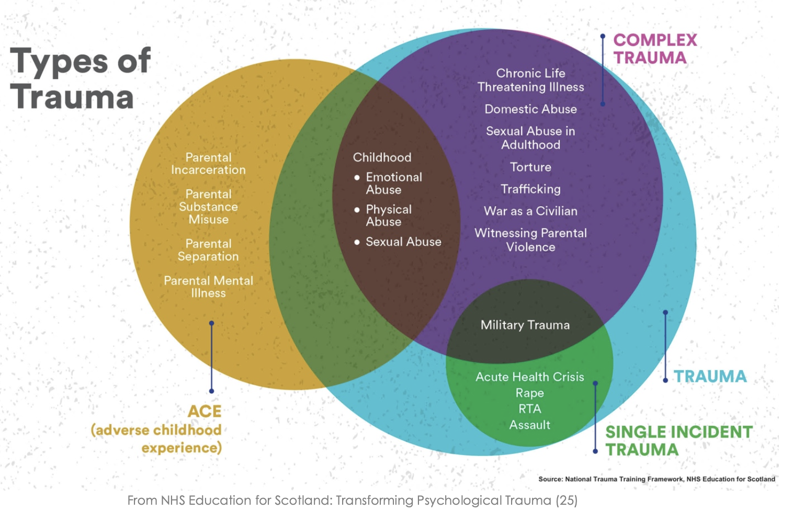
Notes:
ACE
Can induce permanent changes in the neurobiological or stress regulation system. Probably reversible the younger the child is
Problems with emotion regulation and attention regulation
Different vulnerabilities depending on the age of the different neuronal systems

Slide 9
2. Effects of trauma
Trauma impacts on an individual's ability to cope with the normal stressors and stresses of daily life.
This can have physical, emotional, cognitive and behavioural effects.

Slide 10
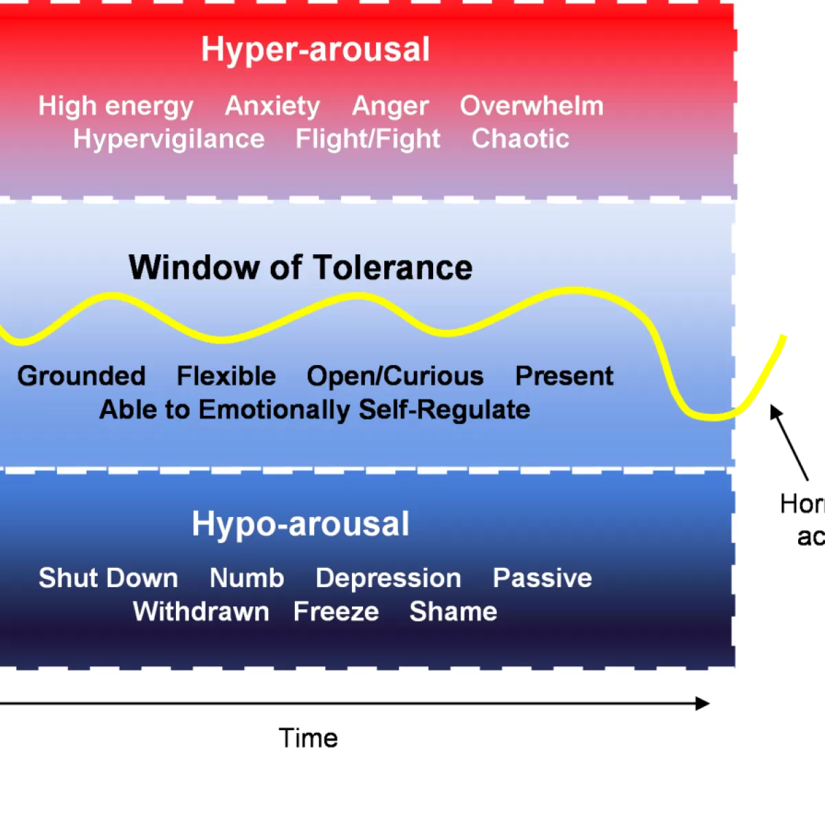
Notes:
This is to say that apparent lack of interest, withdrawal signs etc can often be misinterpreted and can instead result from trauma

Slide 11
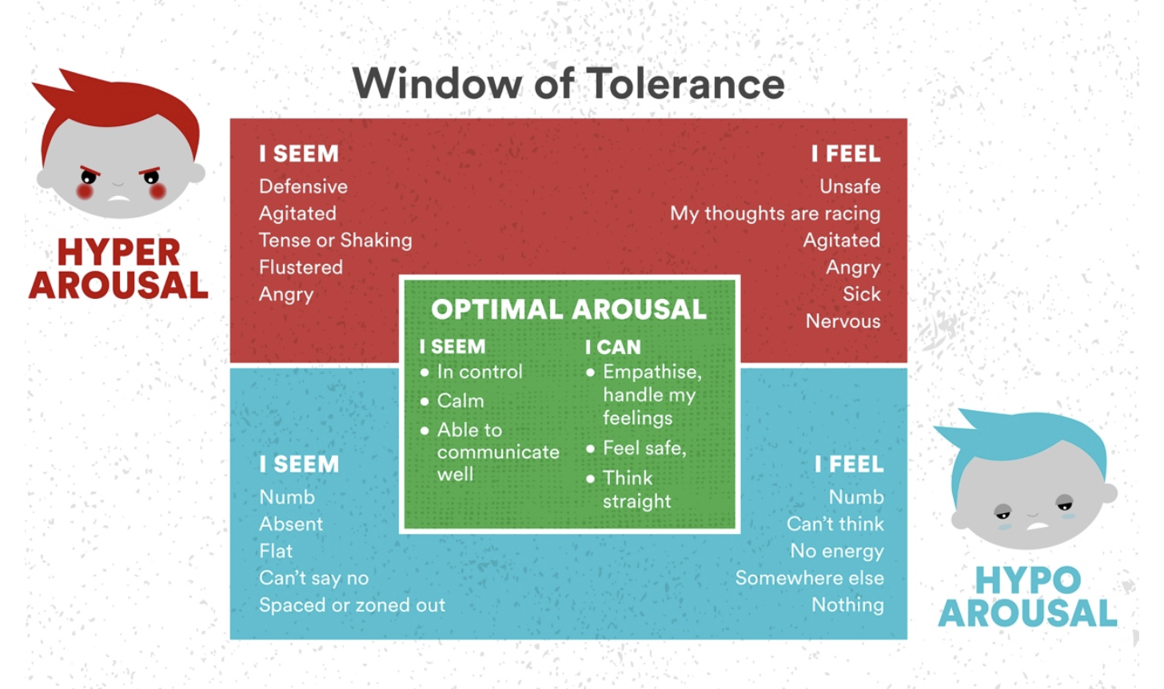

Slide 12
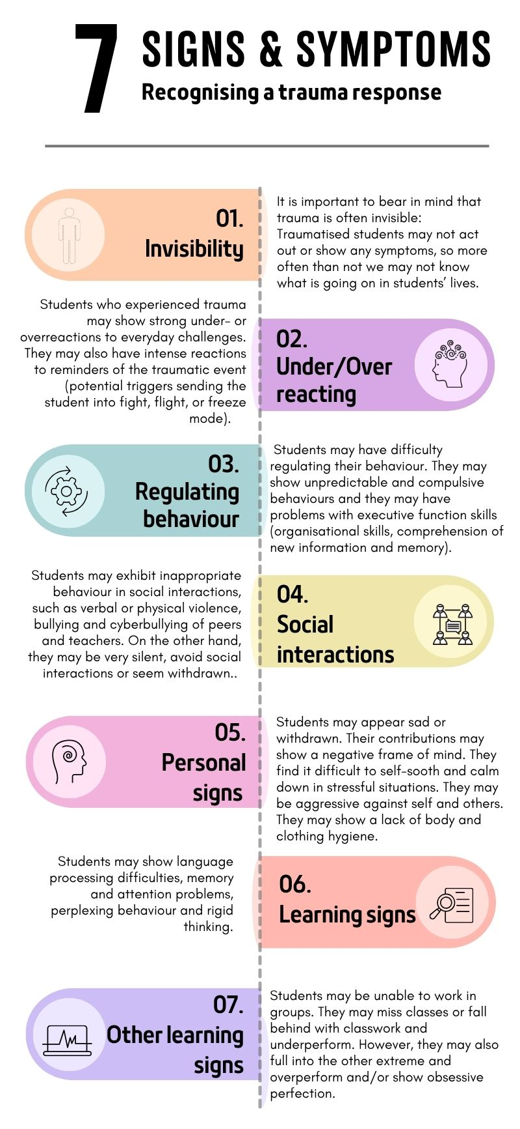
3. How might we recognise a trauma response in the classroom?
https://www.trauma-sensitive-teaching.org

Slide 13
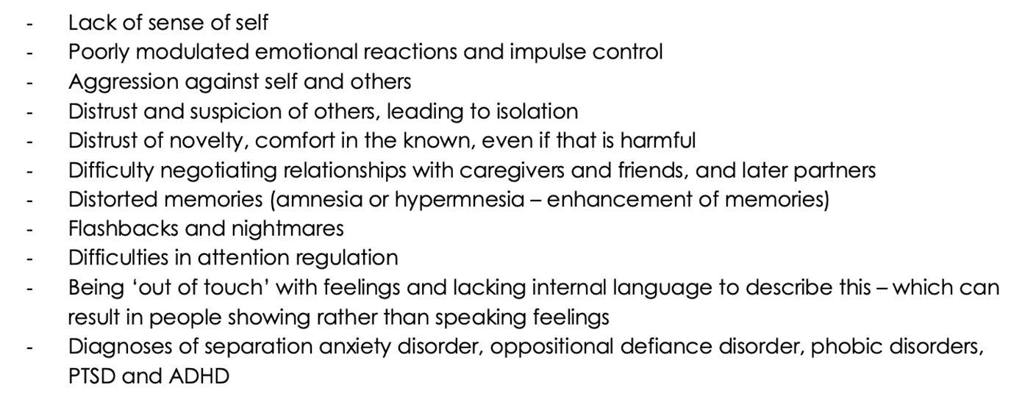

Implications
(Dermody et al. 2018)
Notes:
For us important to know: difficulties to manage cognitive processes, such as memory, attention, thinking, to regulate behaviour; or to control the expression of emotions.

Slide 14
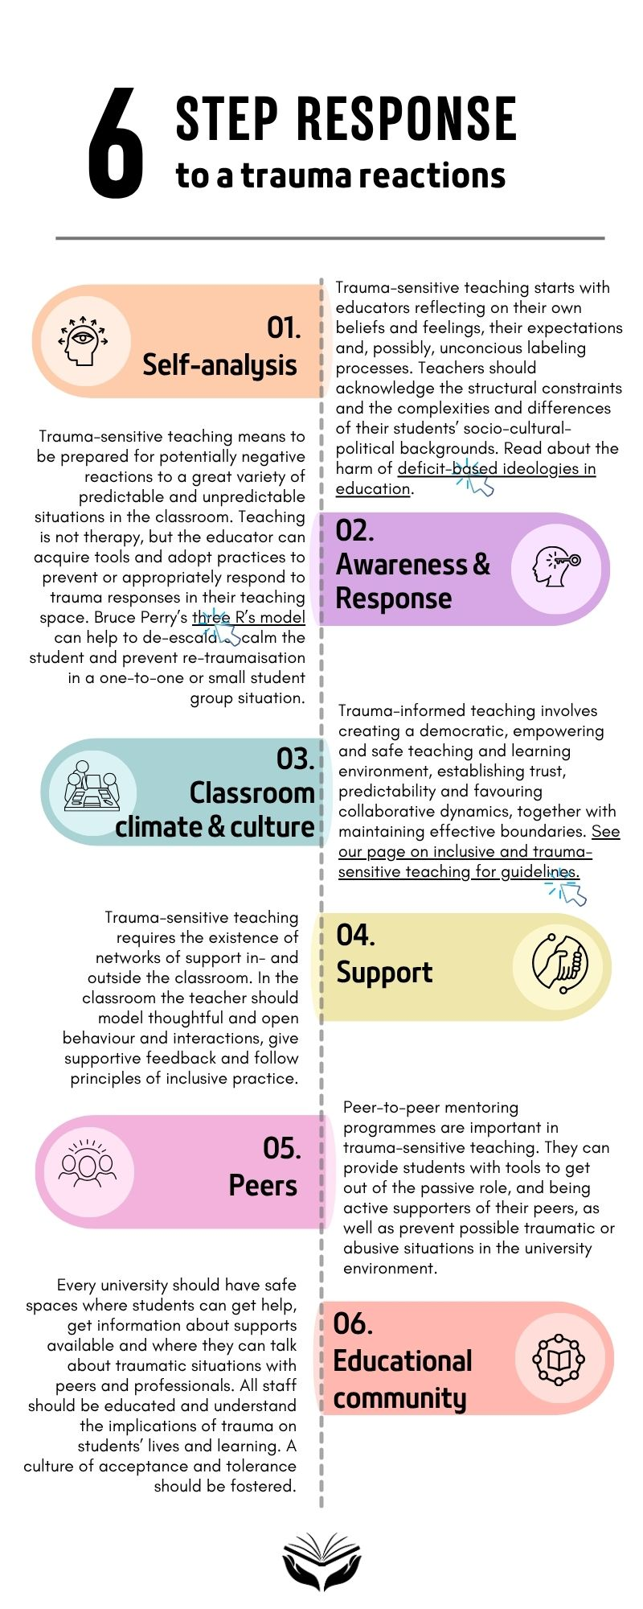
4. What do we do if a student exhibits a trauma response?

Slide 15
Teacher performance has a dual focus
Prevention
First response

Slide 16
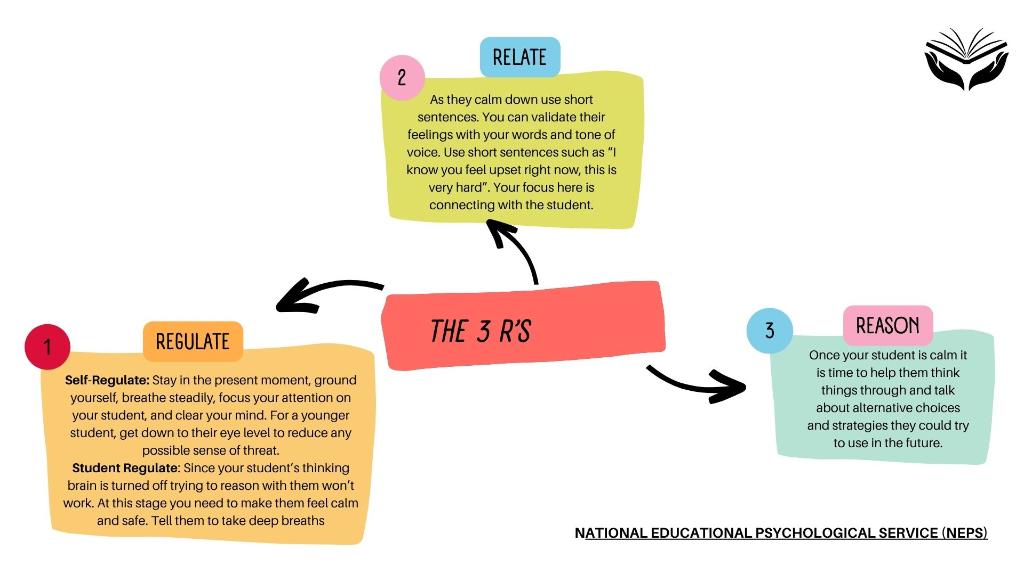

Slide 17
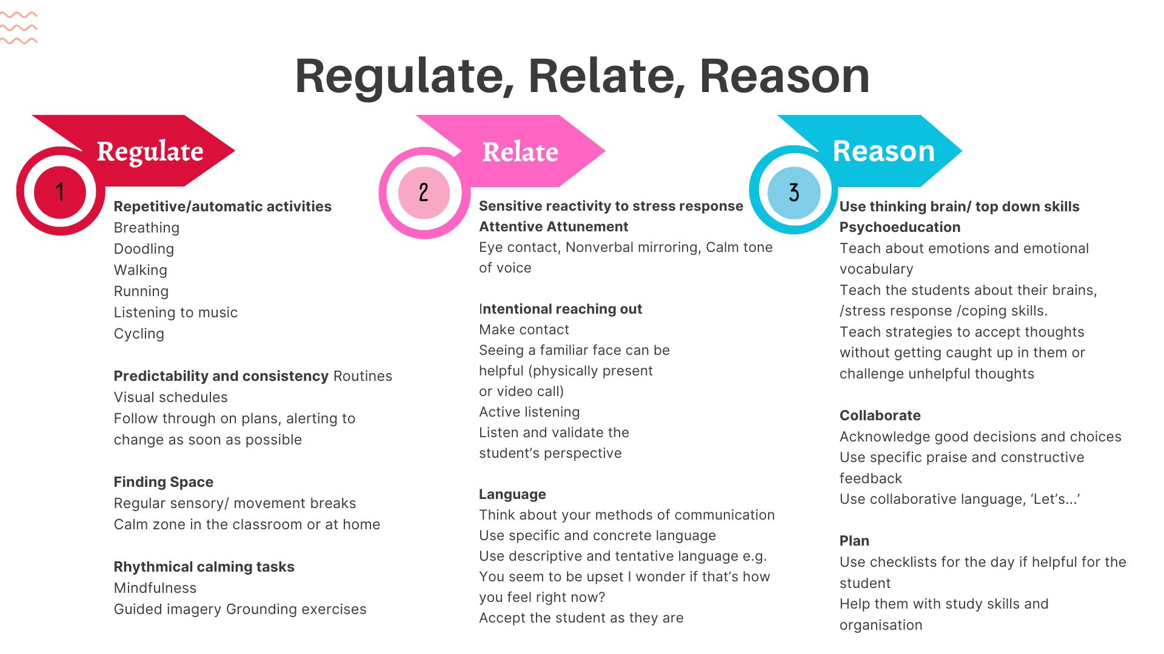

Slide 18
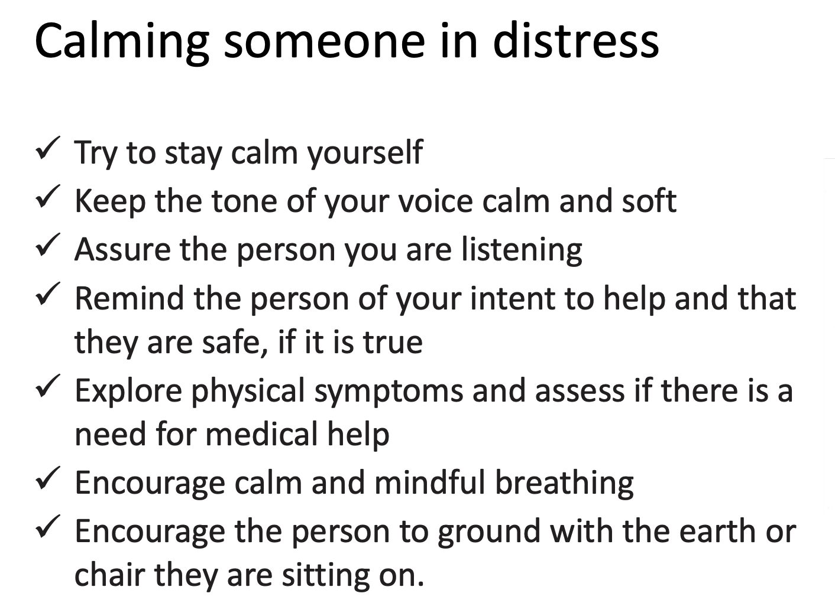

Slide 19
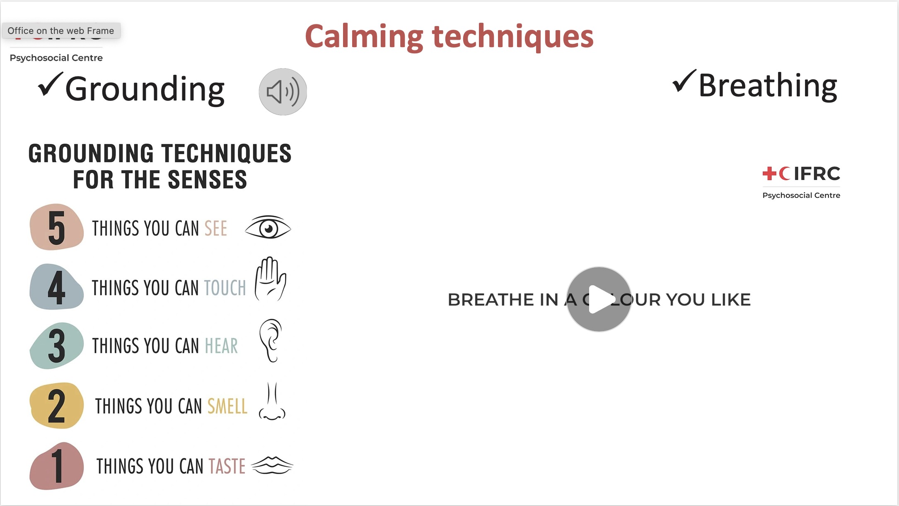

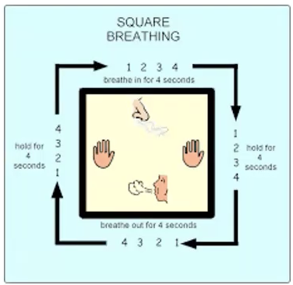

Slide 20
Things you can say to them after grounding
Explain to the person that what they are experiencing is a very normal way of coping with their situation or with circumstances that are outside of their control.
Explain that this is not their fault, but a result of what happened to them.
Tell them that they are safe now.
Ask them if they have experienced this before and what normally helps them (empowerment).

Slide 21
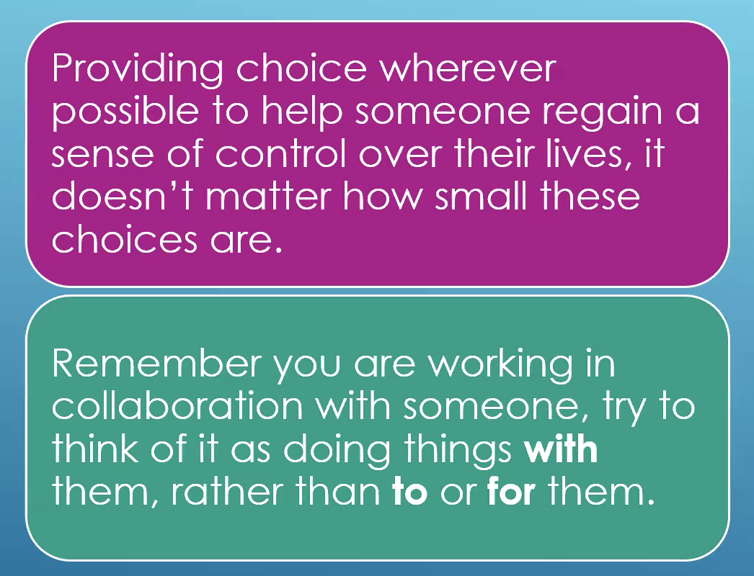
Restoring choice and control

Slide 22
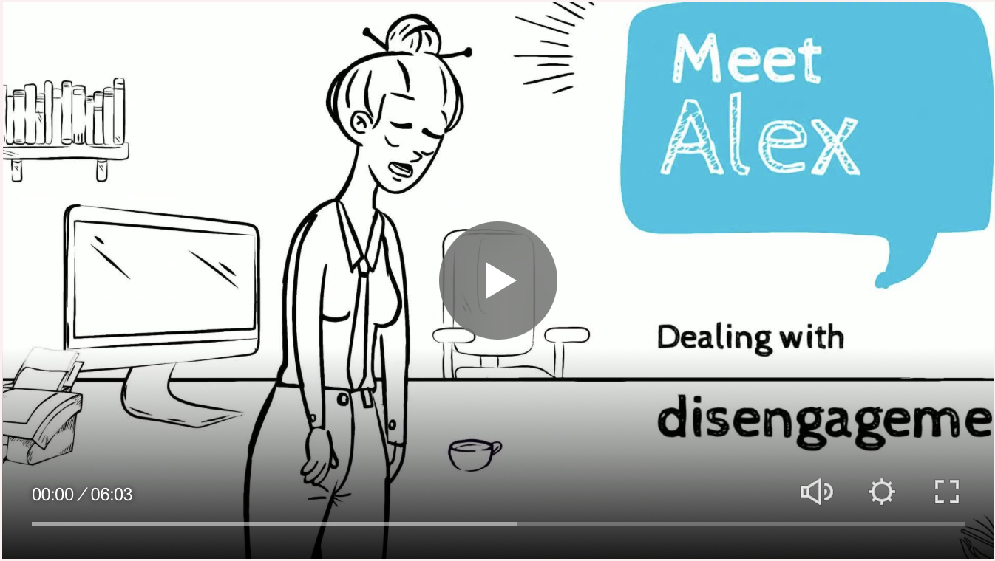
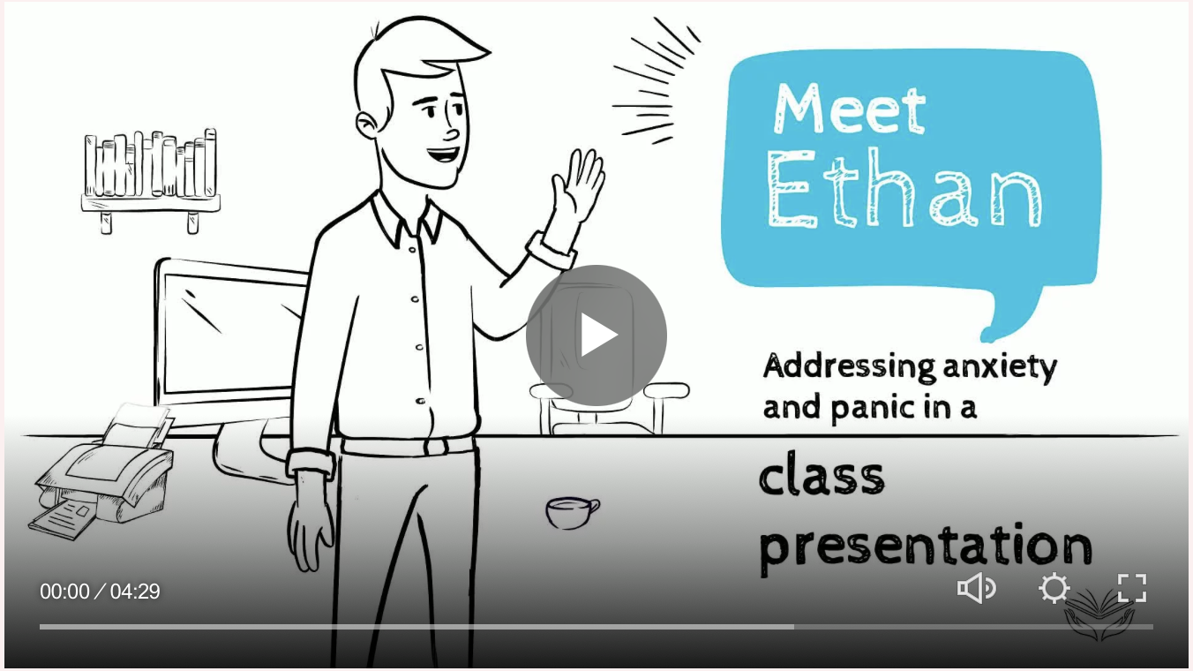
www.trauma-sensitive-teaching.org

Slide 23
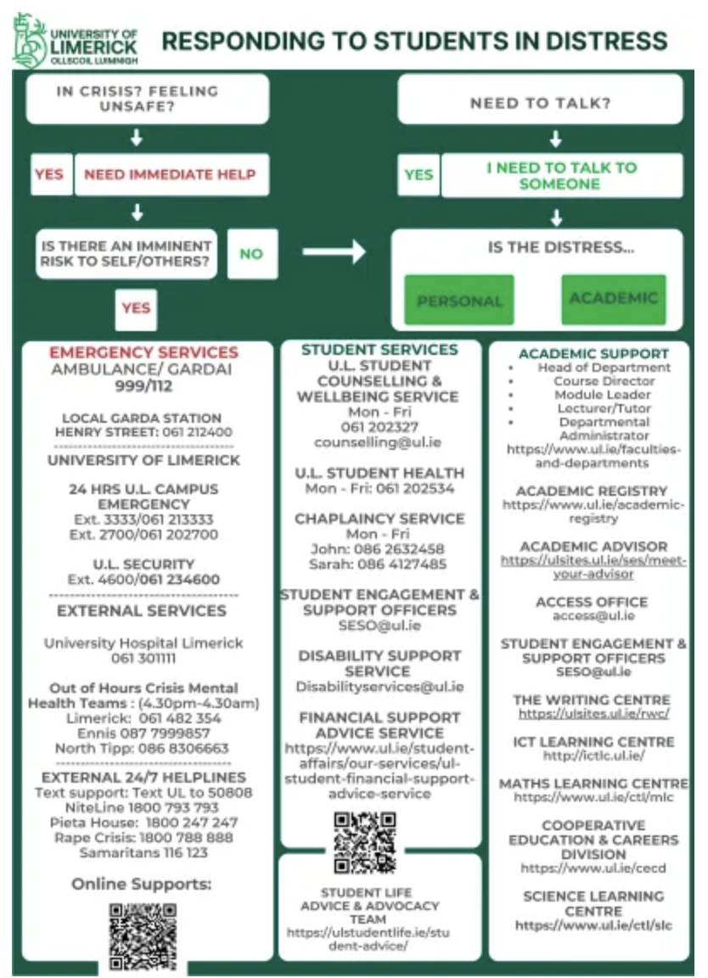
UL Student Counselling Service
https://www.ul.ie/student-affairs/counselling-service/resources-for-staff
Notes:
Please check if you have a similar system at your institution.

Slide 24
5. How to prevent a trauma response/ retraumatisation
...when engaging in:
Planning
Teaching
Feedback and reflection

Slide 25

Consider
What you know and understand about inclusion and trauma
Your diverse student audience
Develop
A detailed schedule and syllabus
Plan
The learning outcomes and assessments
Adapt if required
Make
Students visible

Slide 26

Get to know your students
Watch out for signs of trauma
Use icebreaker activities
Communicate
The syllabus
Provide
A list of organisational services and (peer) networks
Create
A safe learning environment
Clear expectations
(1 of 2)

Slide 27
Different types of assessments
Make
Appropriate technology choices
Offer
Wrap-up sessions
Choice
Maximise
Consider
Student diversity when adopting teaching methods
(2 of 2)

Slide 28

Ensure feedback is
Timely and provided frequently
Provided in sufficient detail to facilitate success
Understandable, received, and acted upon by students
Self and peer evaluation
Provide opportunities for
Inclusion
Trauma
Evaluate the course from different perspectives
Pedagogy

Slide 29
Useful Resources for Teaching and Learning
Detailed guidelines for planning https://www.trauma-sensitive-teaching.org/planning
Detailed guidelines for teaching https://www.trauma-sensitive-teaching.org/teaching
Detailed guidelines for feedback and reflection https://www.trauma-sensitive-teaching.org/feedback

Slide 30

References
Maté, G. (2022): The myth of normal: Trauma, illness and healing in a toxic culture. London: Penguin.
Hunter, J. J. (2022). Clinician’s voice: Trauma-informed practices in higher education. In T. R. Shalka & W. K. Okello (Eds.), Trauma-informed practice in student affairs: Multidimensional considerations for care, healing, and wellbeing (New Directions for Student Services, 177, 27–38). Wiley.
Le Pichon, S. & Lundy, S. (2023). Trauma-Informed Pedagogy at the Grassroots. Building and Sustaining a Trauma-Informed Movement at a Large Public Institution. In: E. Stromberg (ed.) Trauma-Informed Pedagogy in Higher Education. Routledge.
Well, T. (2023). Creating Trauma-Informed Higher Education Classrooms. Exploring Undergraduate and Graduate Student Perceptions. Journal of Effective Teaching in Higher Education , vol. 6, no. 1

